Slide 1
Introduction to GenAI & LLM
Nguyễn Tuấn Anh (阮俊英)
Foxconn. AI

Slide 2
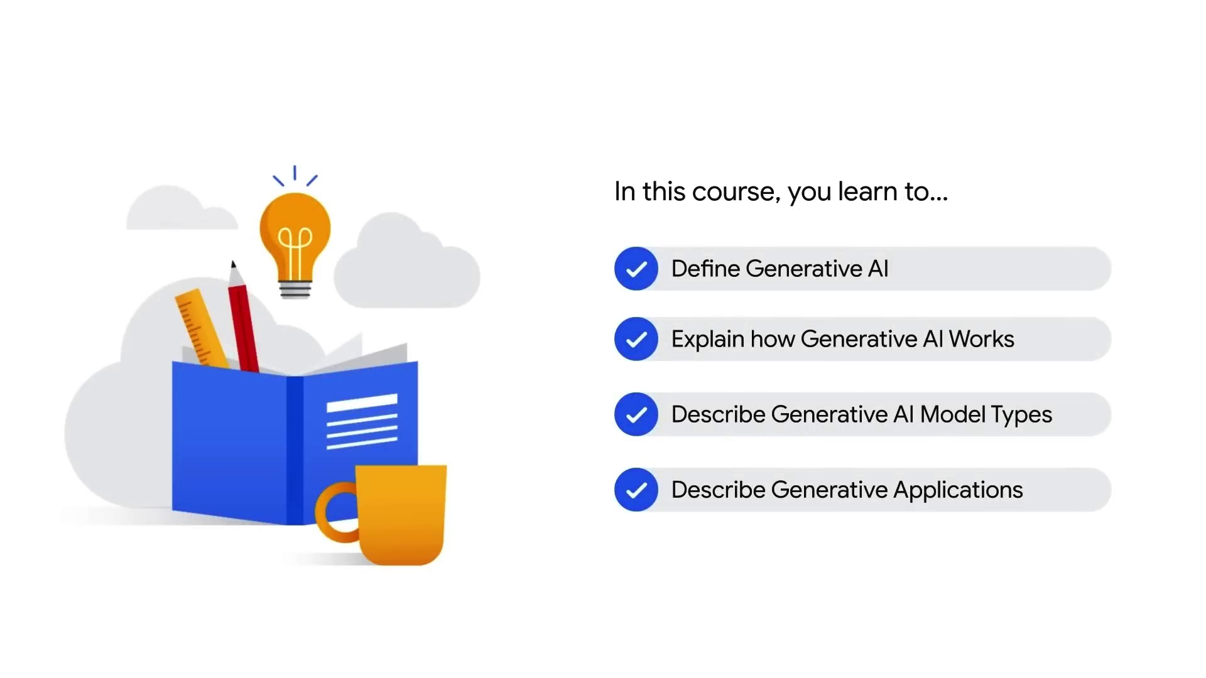
Introduction to GenAI & LLM

Slide 3
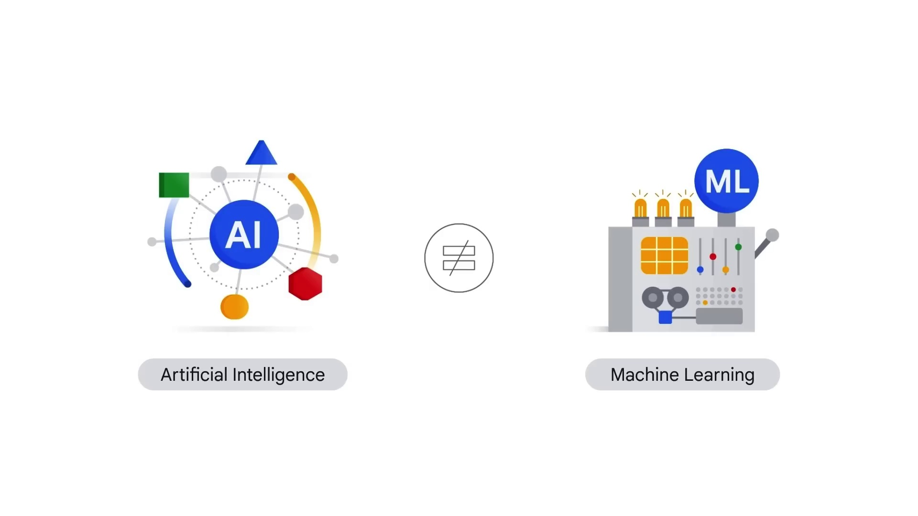
Introduction to GenAI & LLM

Slide 4
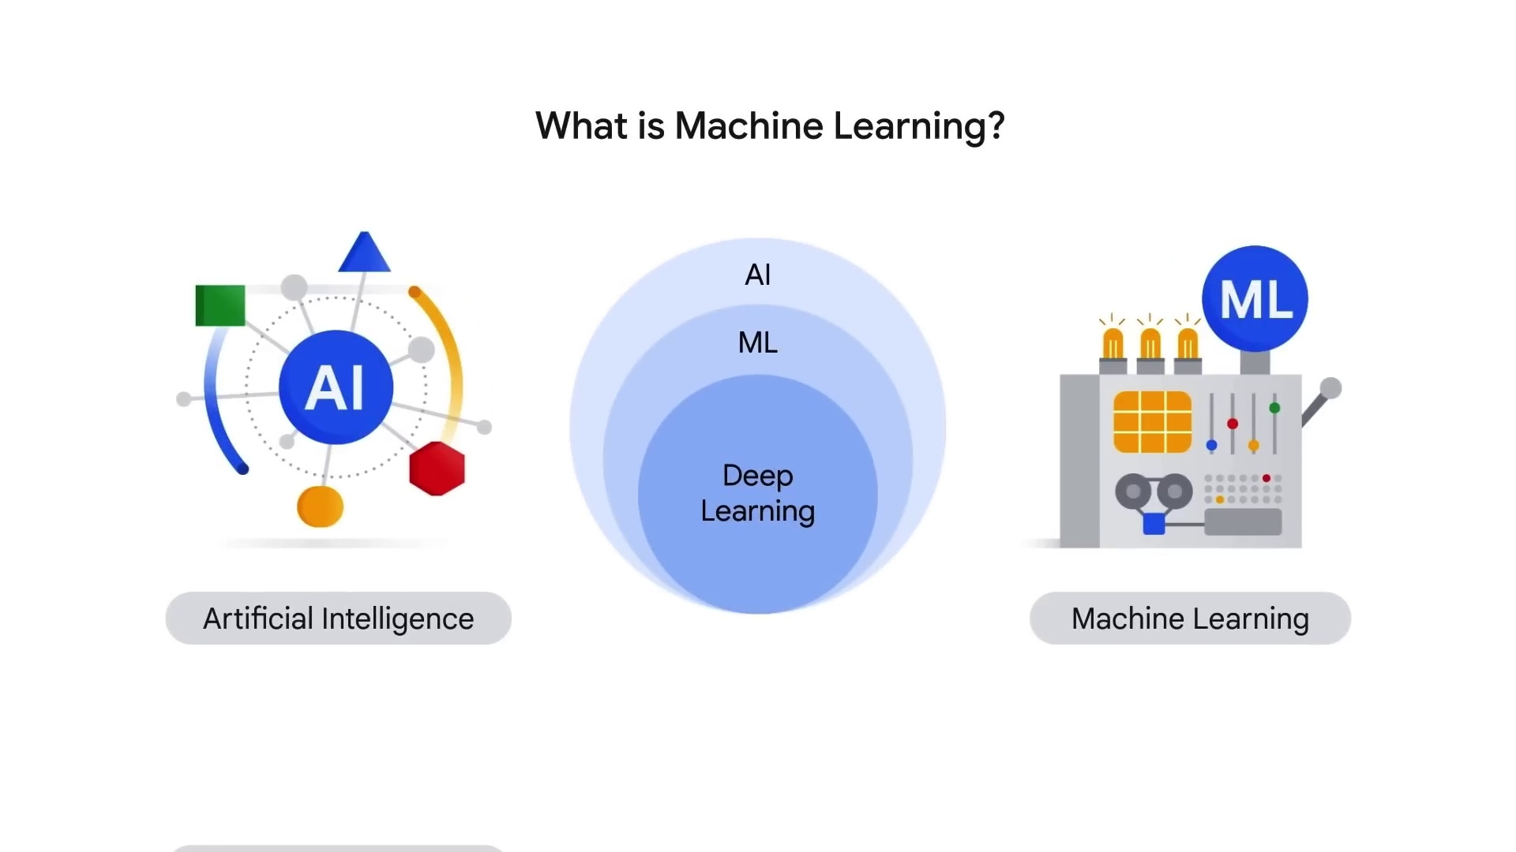
Introduction to GenAI & LLM

Slide 5
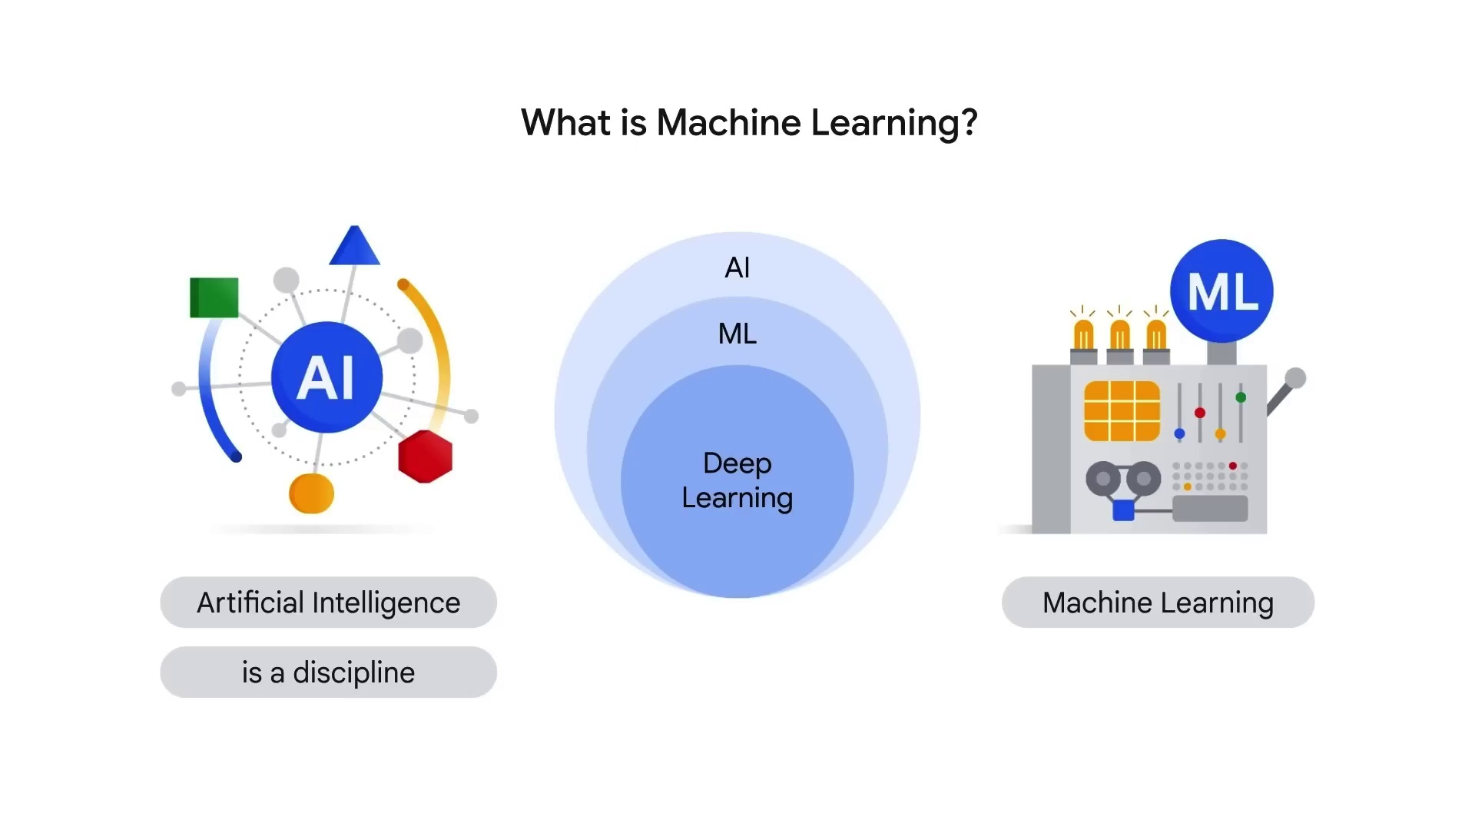
Introduction to GenAI & LLM

Slide 6
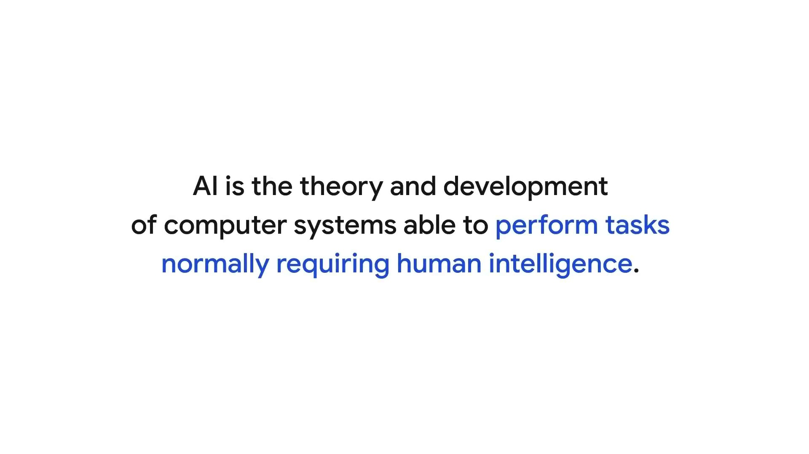
Introduction to GenAI & LLM

Slide 7
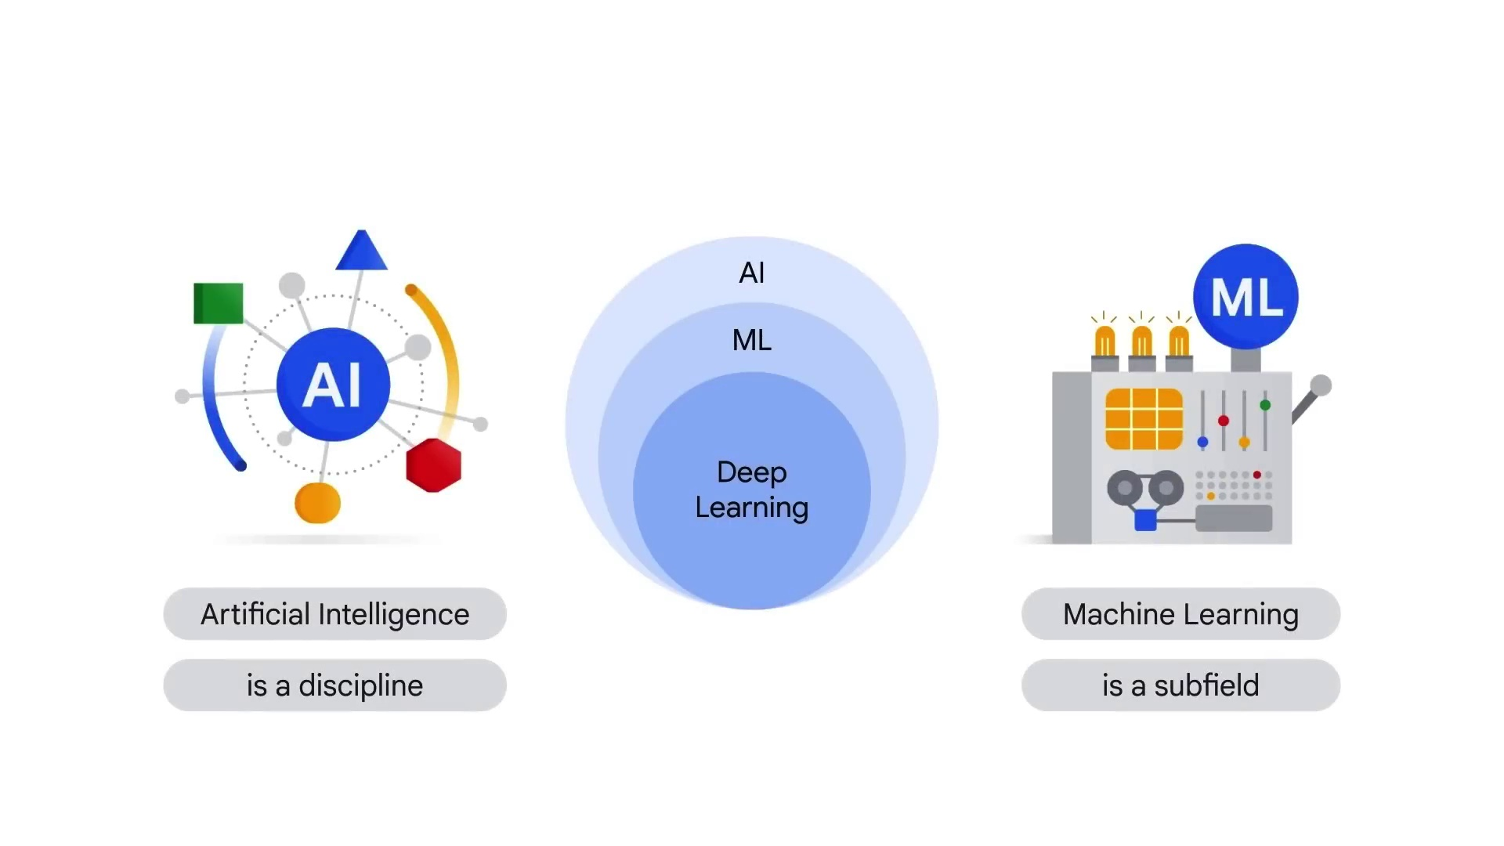
Introduction to GenAI & LLM

Slide 8
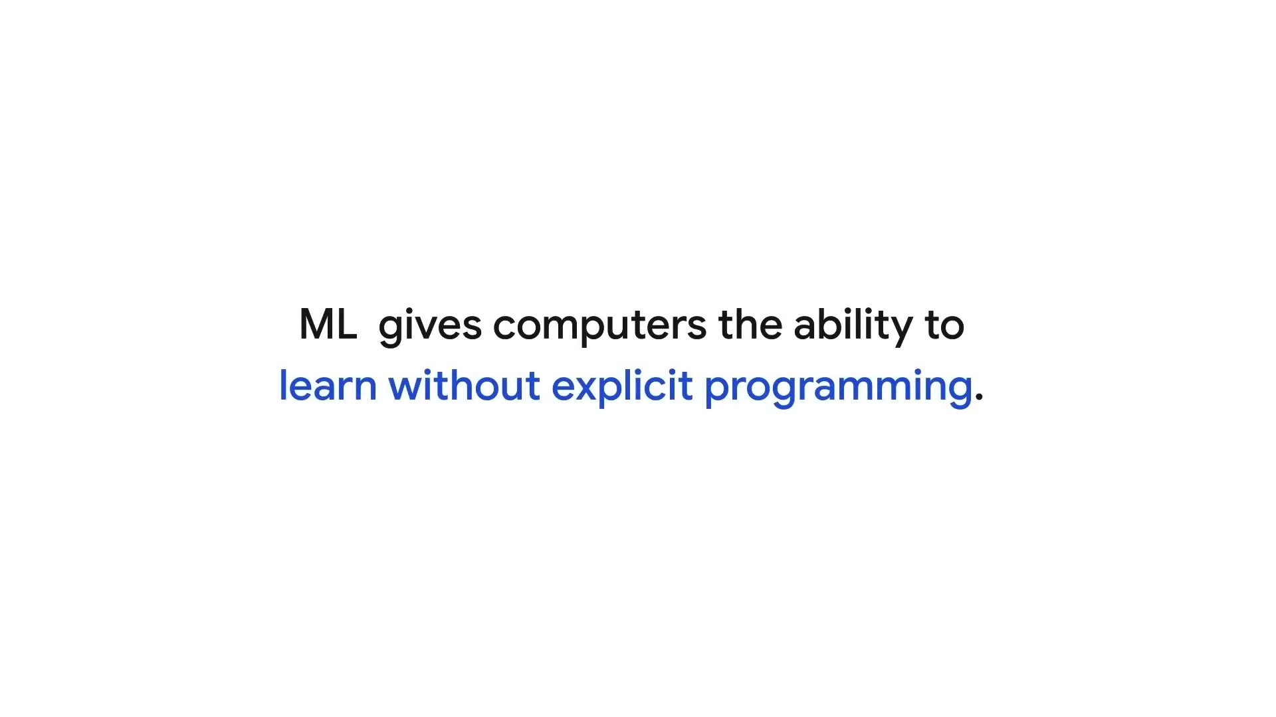
Introduction to GenAI & LLM

Slide 9
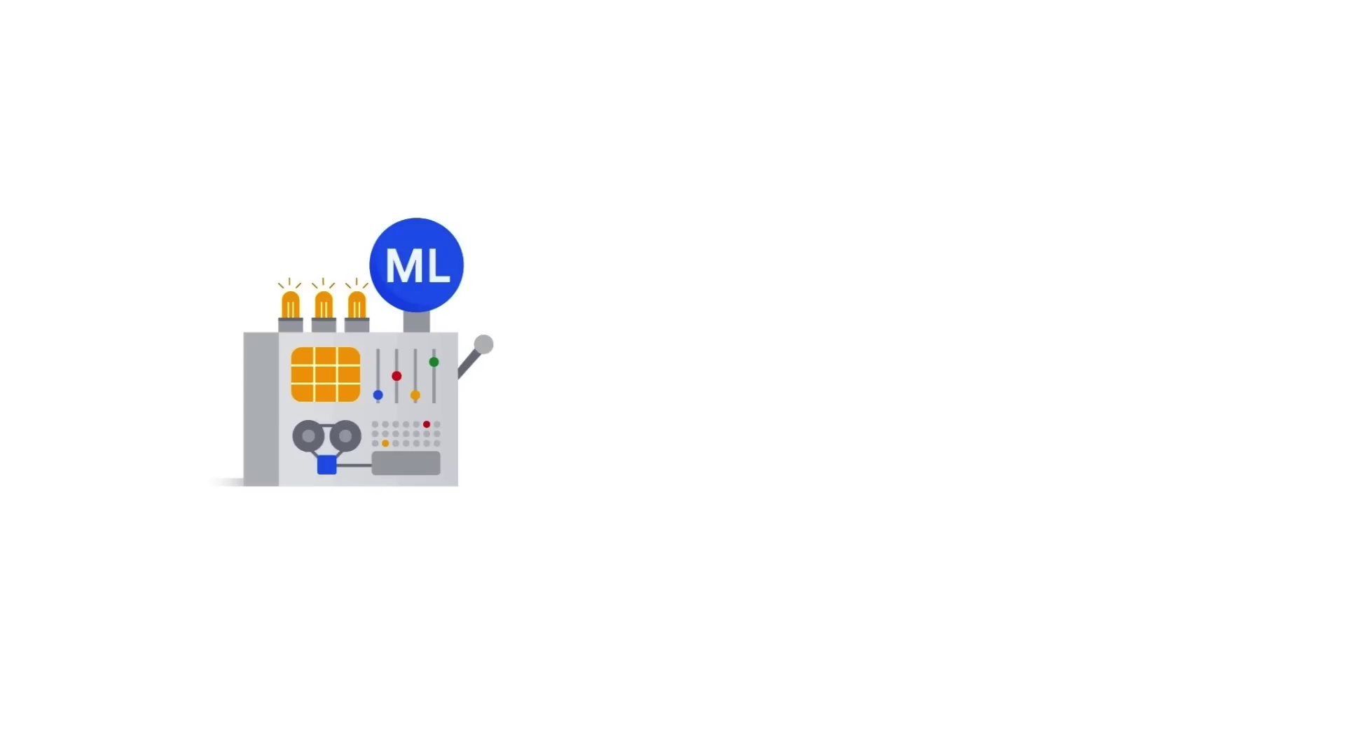
Introduction to GenAI & LLM

Slide 10
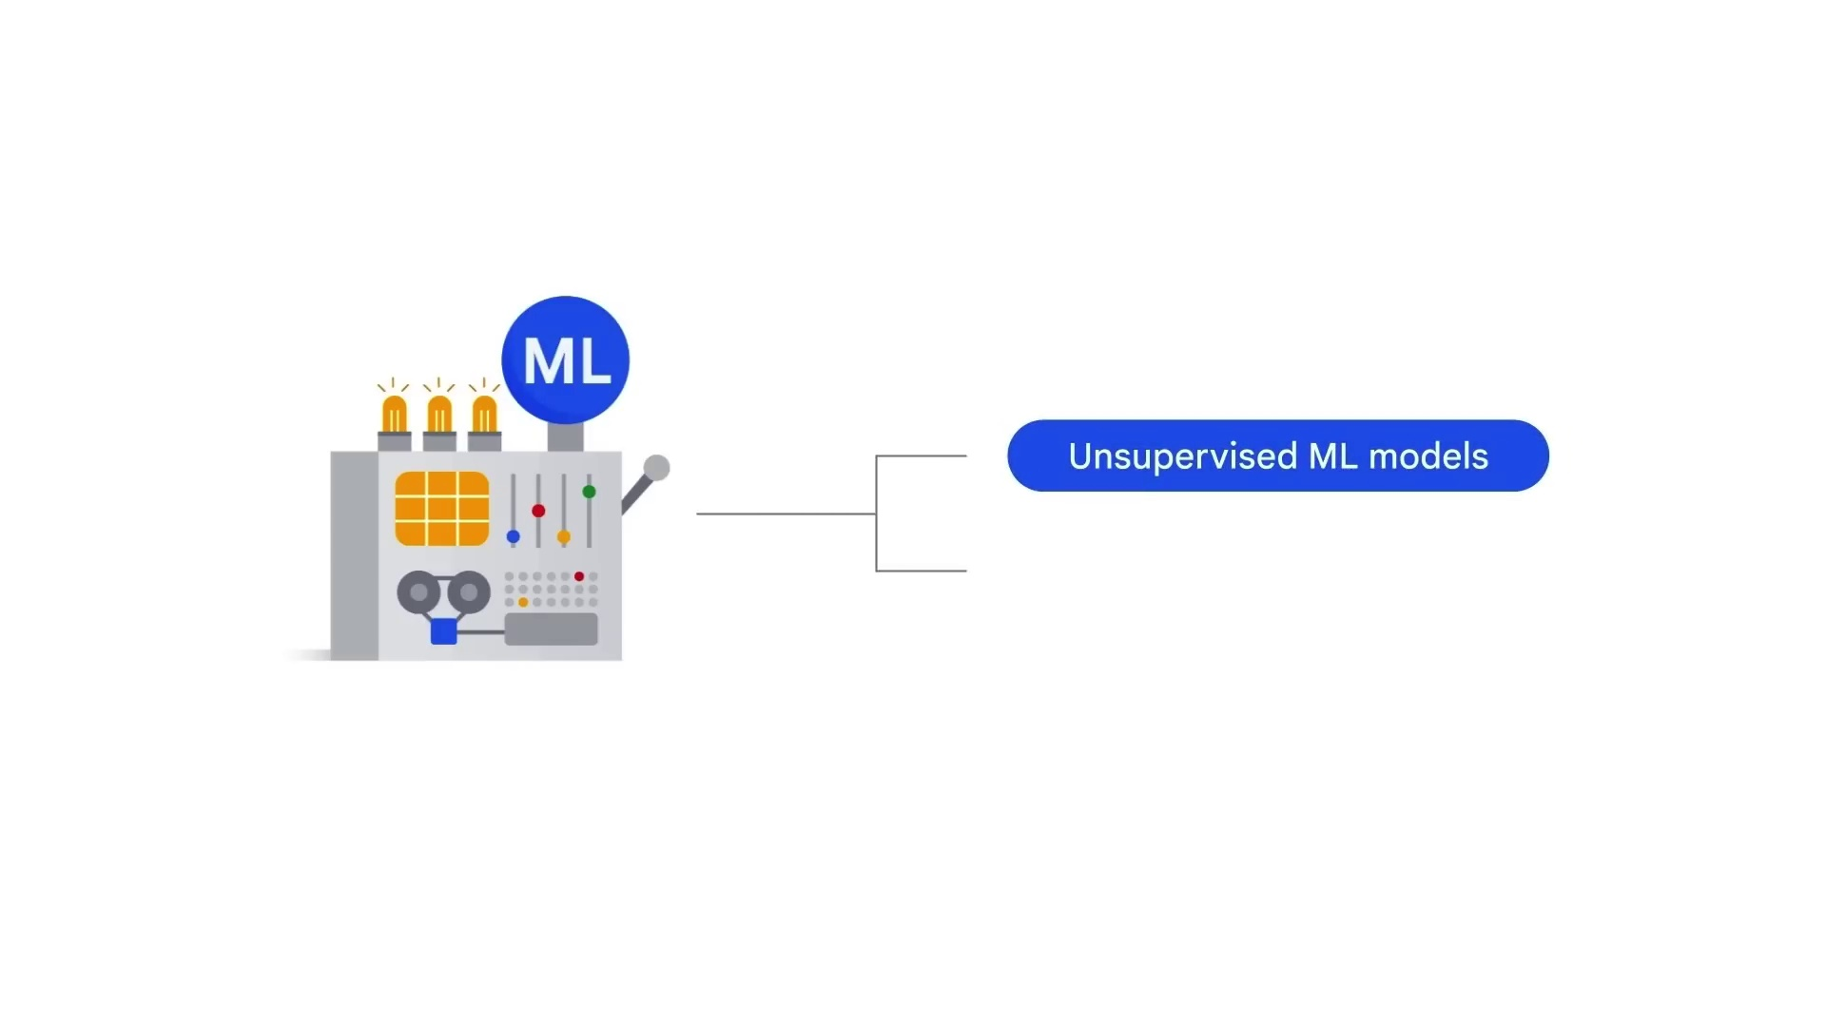
Introduction to GenAI & LLM

Slide 11
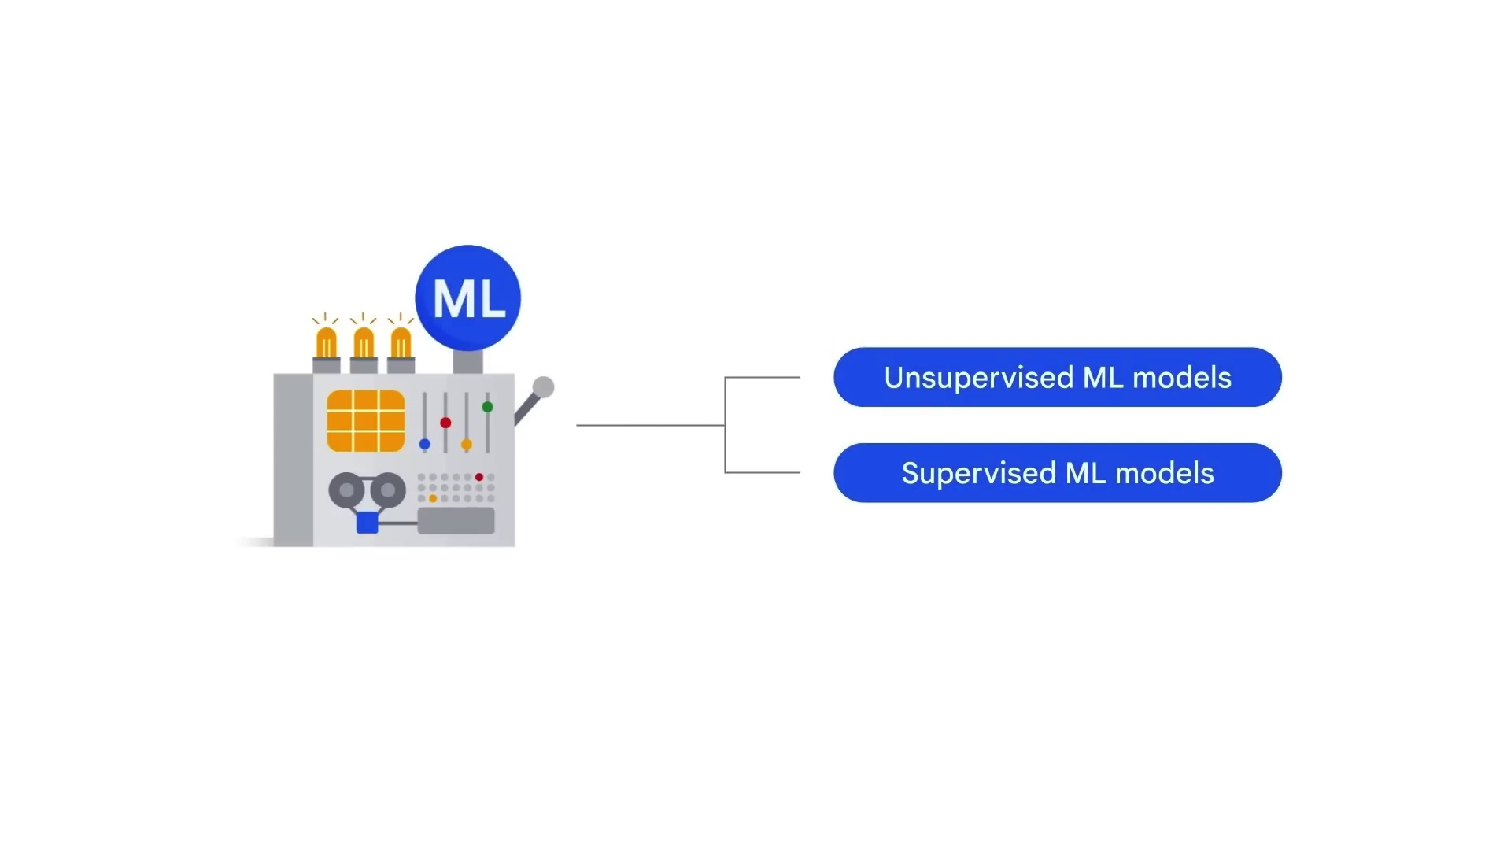
Introduction to GenAI & LLM

Slide 12
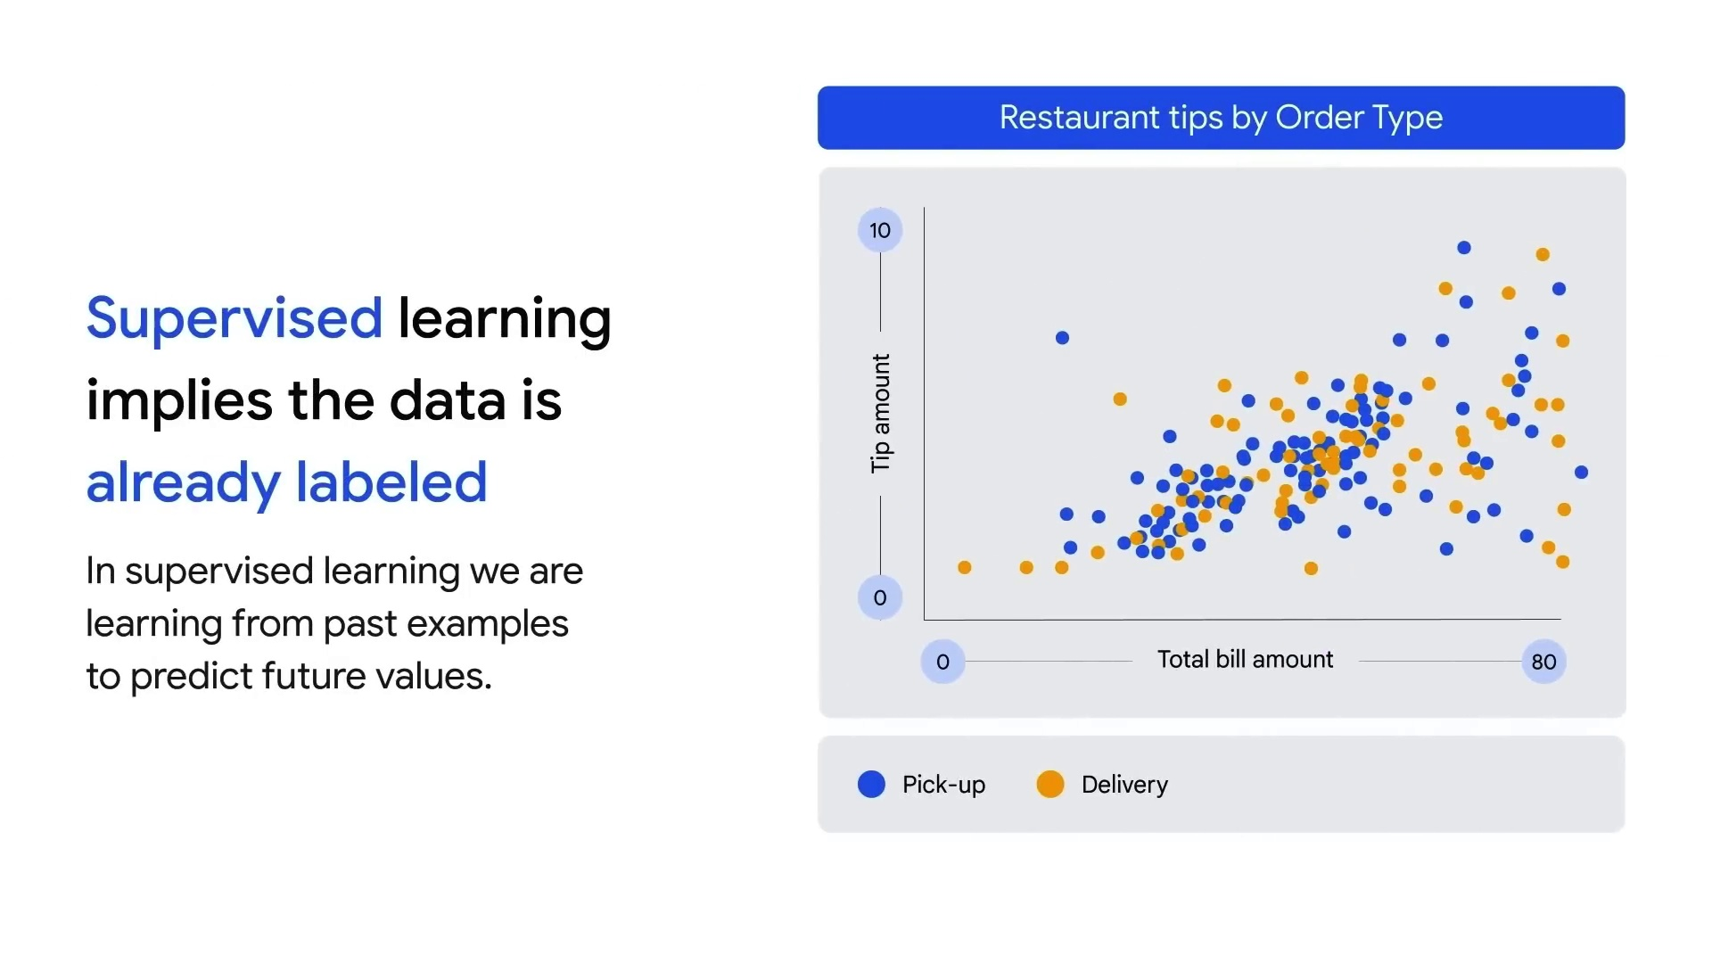
Introduction to GenAI & LLM

Slide 13
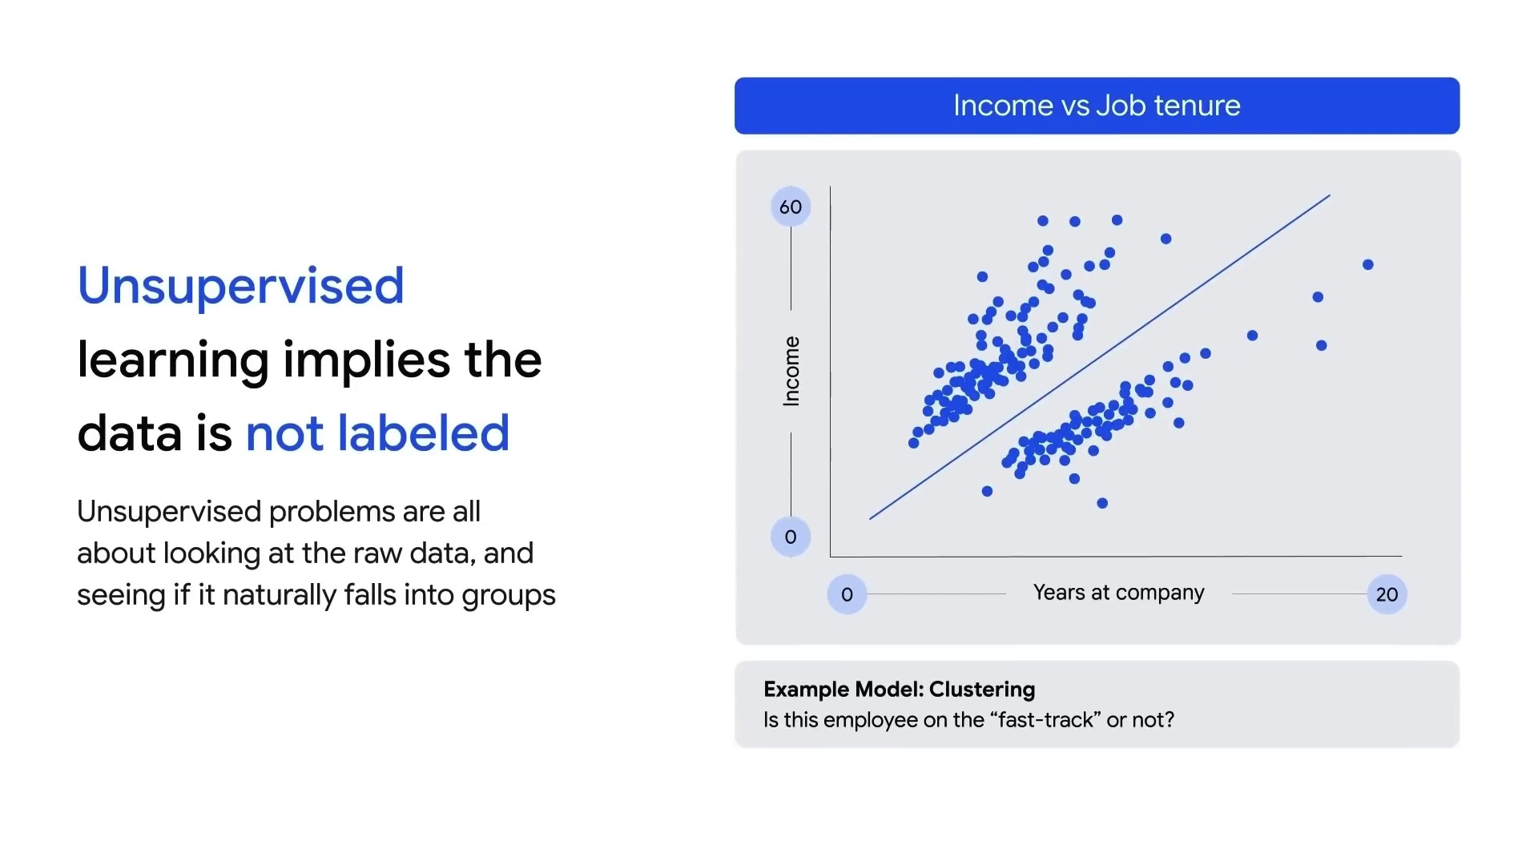
Introduction to GenAI & LLM

Slide 14
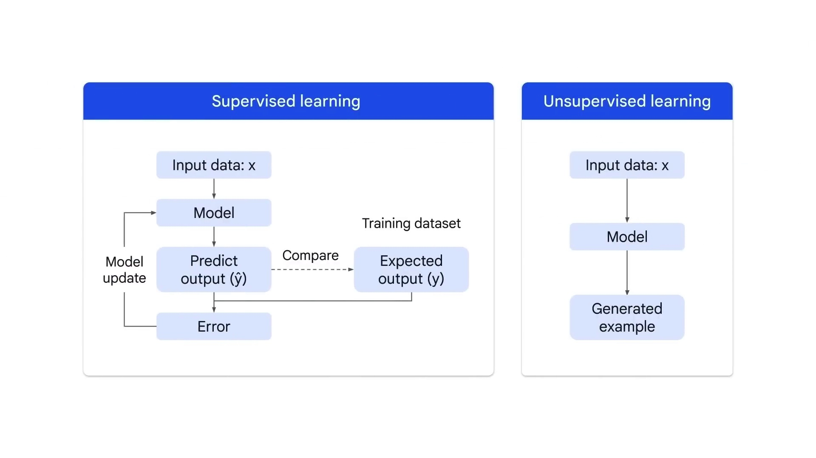
Introduction to GenAI & LLM

Slide 15
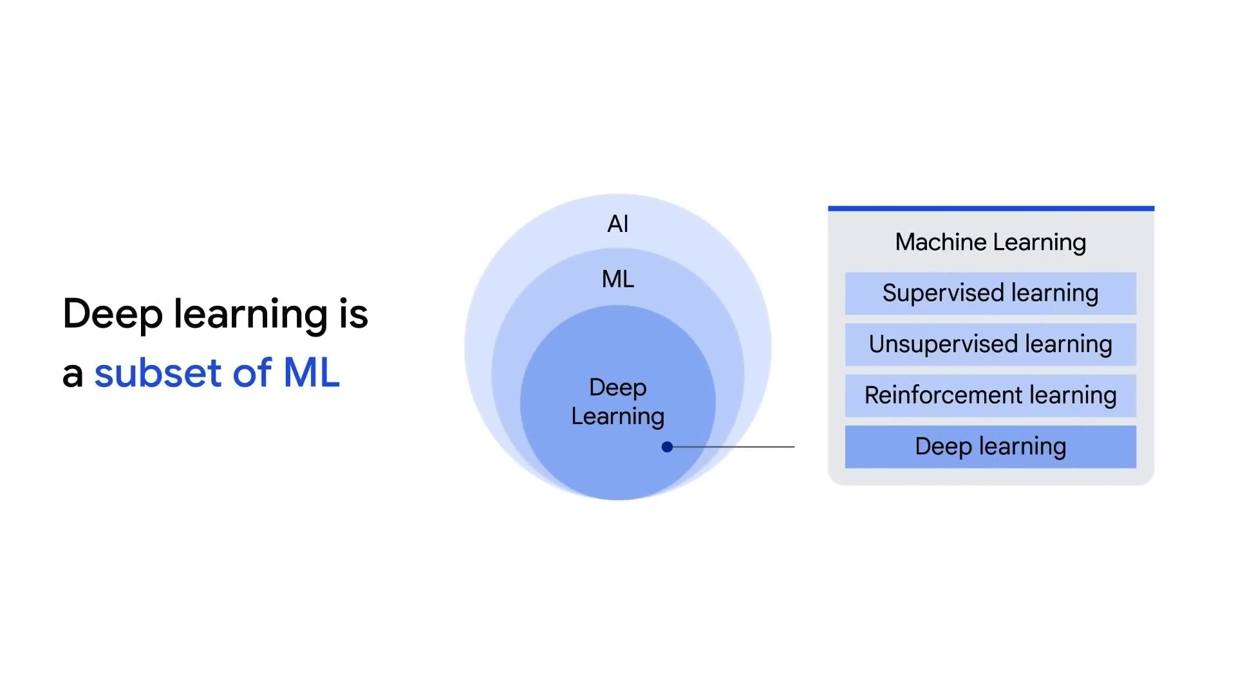
Introduction to GenAI & LLM

Slide 16
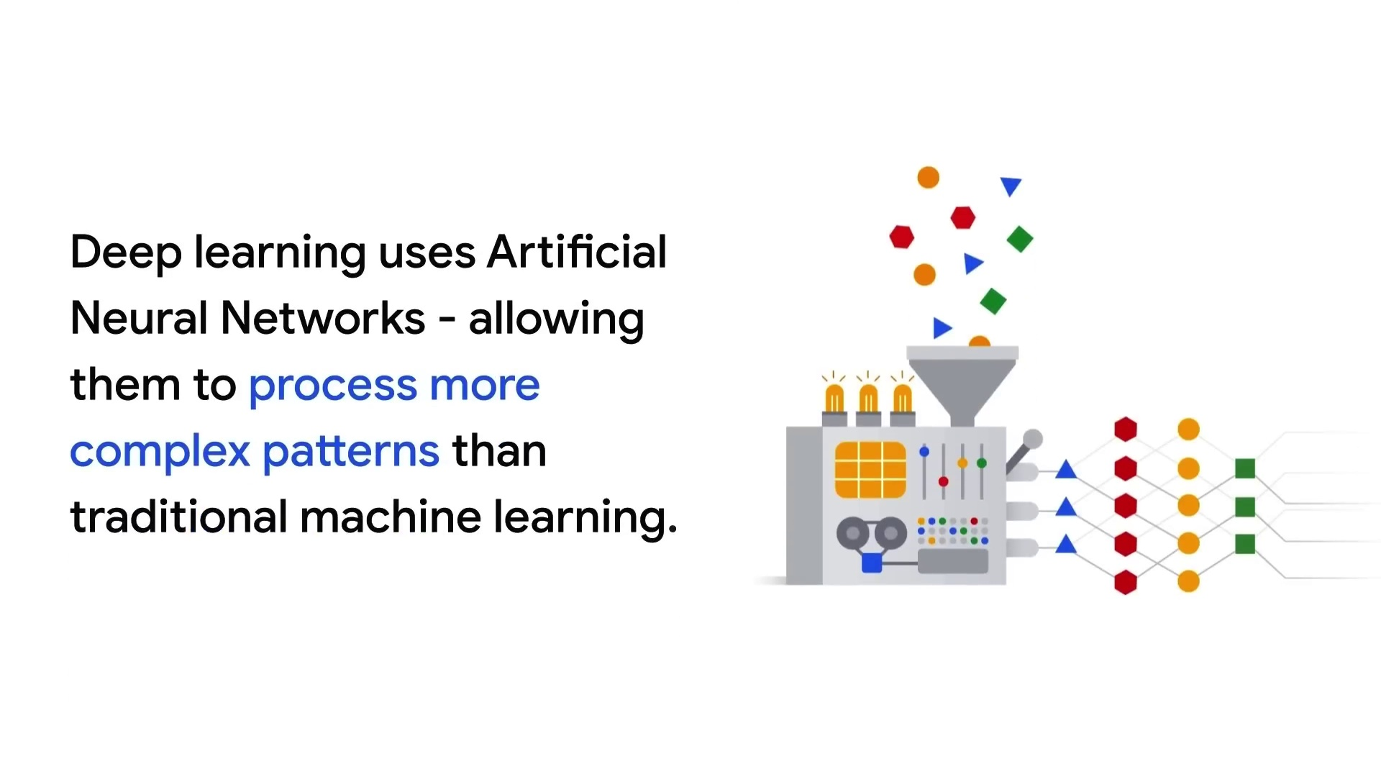
Introduction to GenAI & LLM

Slide 17
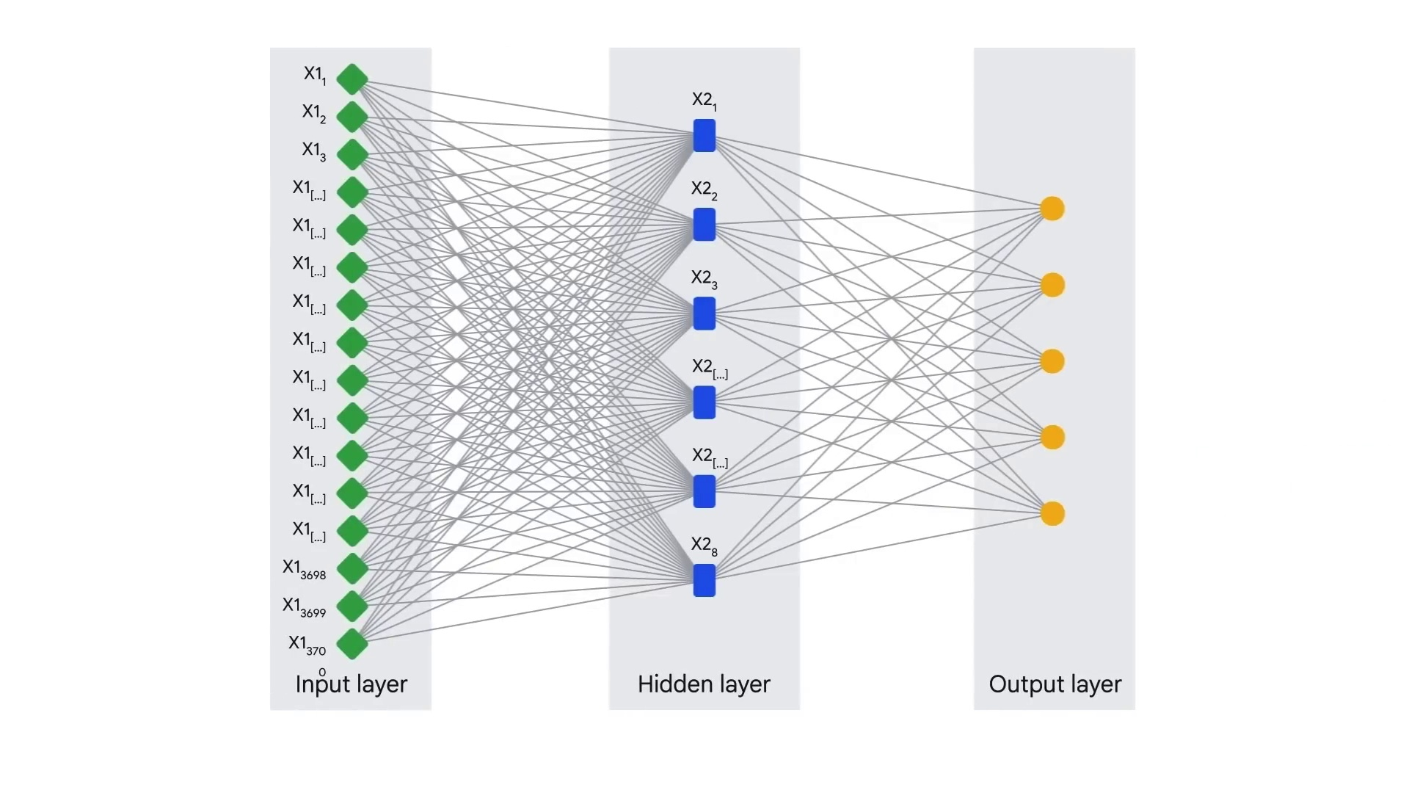
Introduction to GenAI & LLM

Slide 18
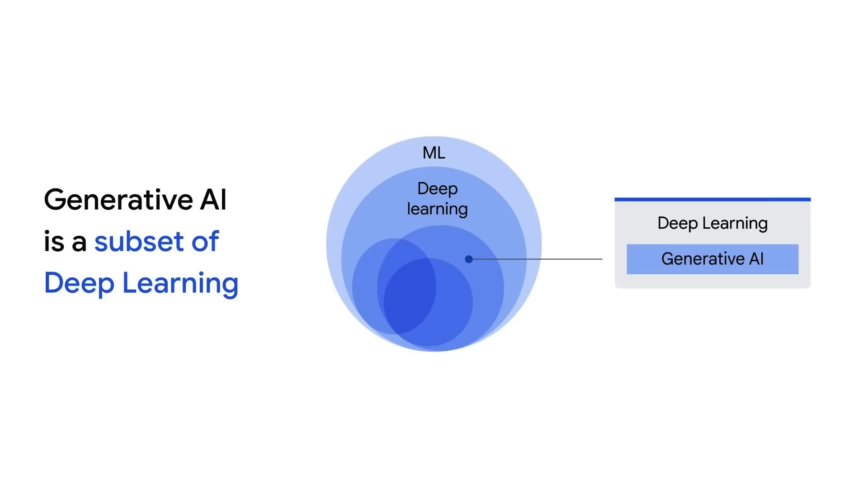
Introduction to GenAI & LLM

Slide 19
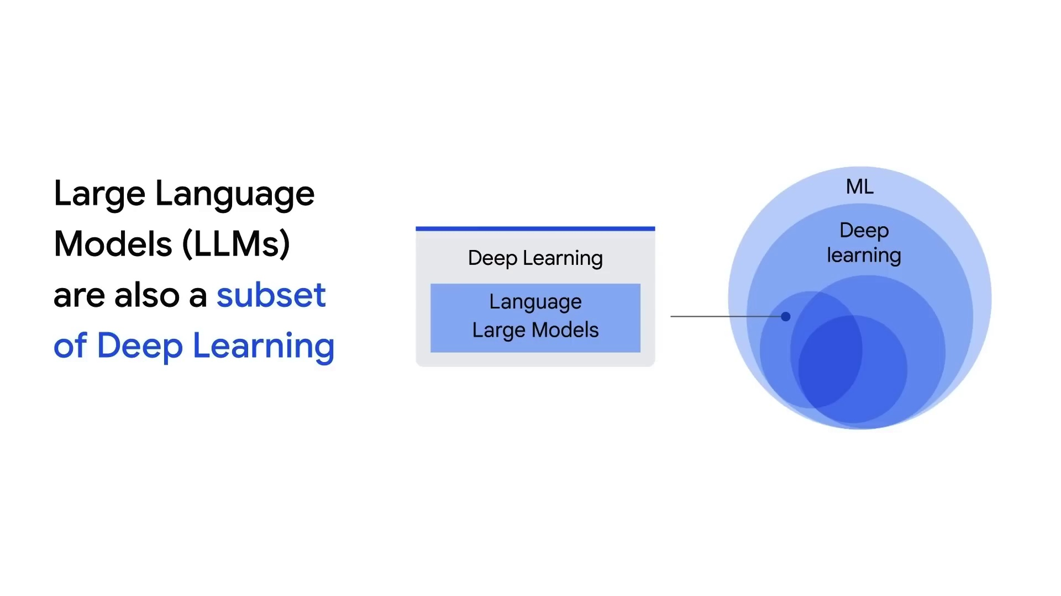
Introduction to GenAI & LLM

Slide 20
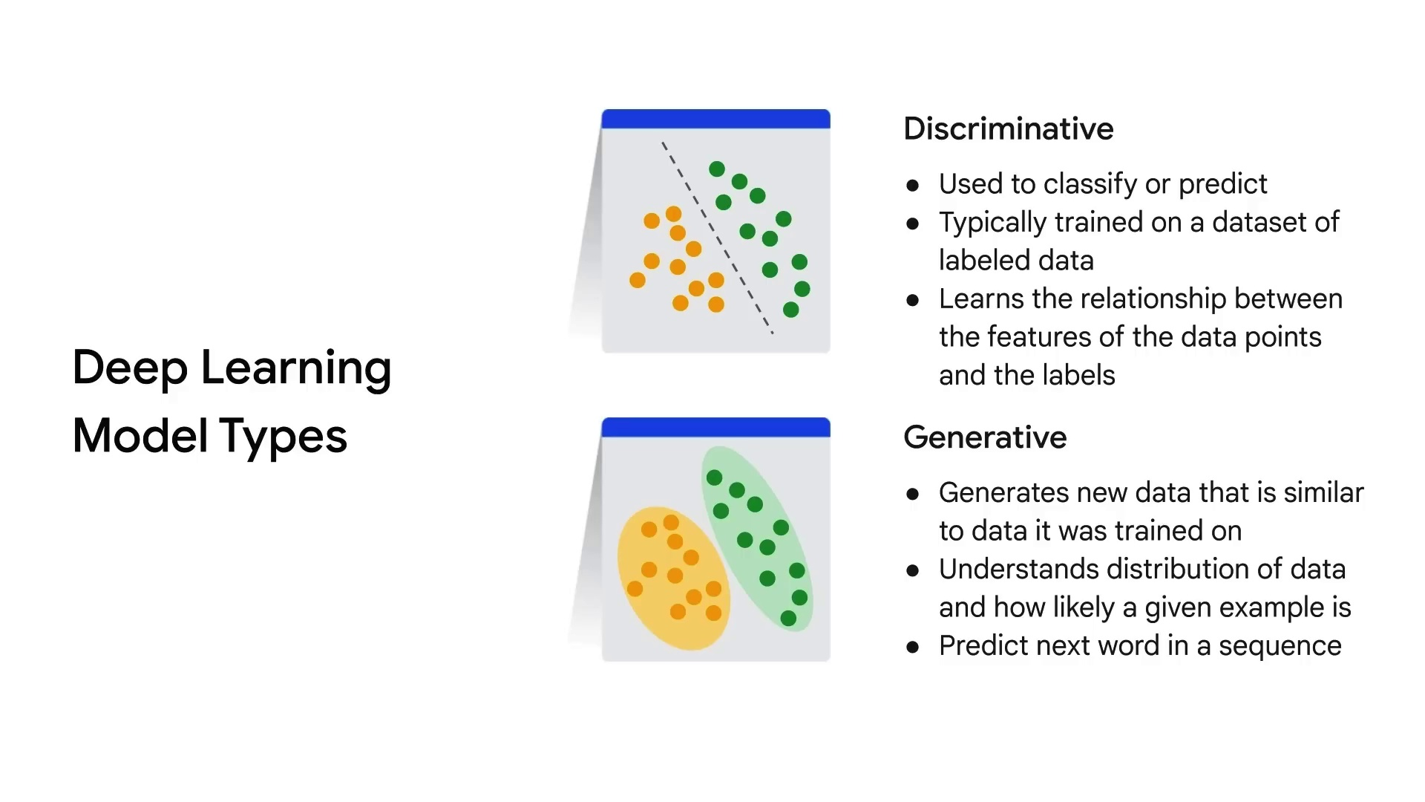
Introduction to GenAI & LLM

Slide 21
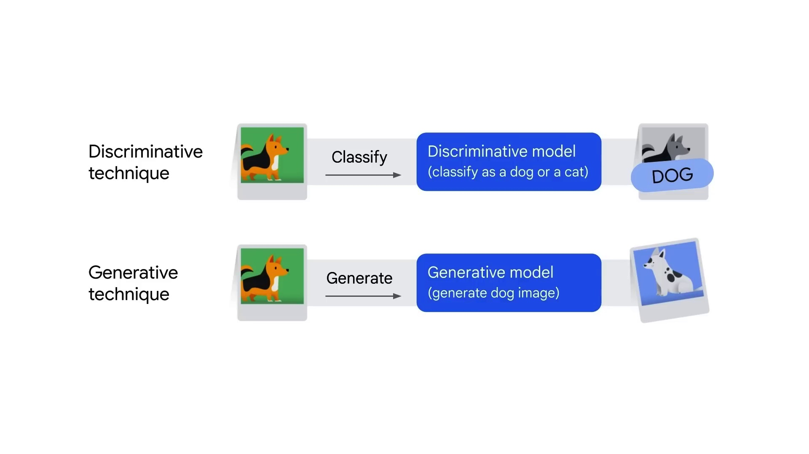
Introduction to GenAI & LLM

Slide 22
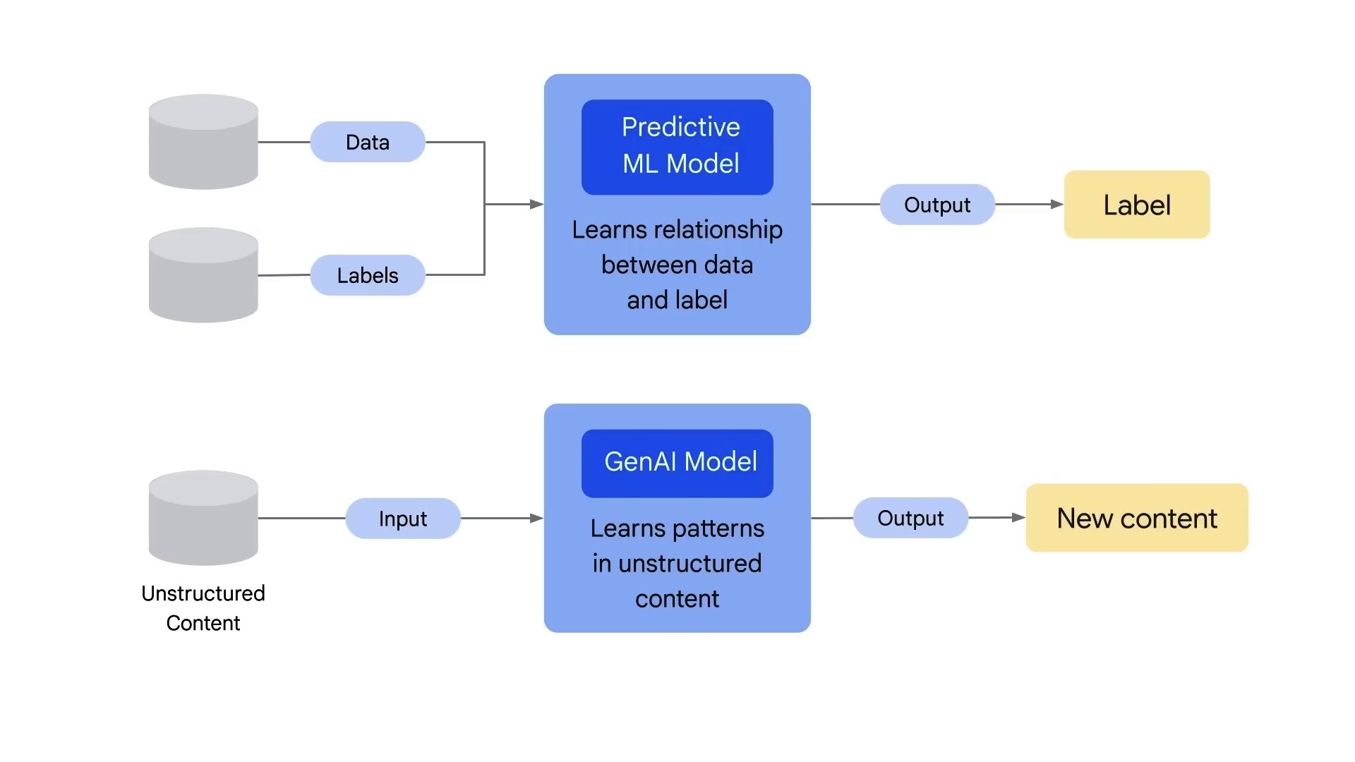
Introduction to GenAI & LLM

Slide 23
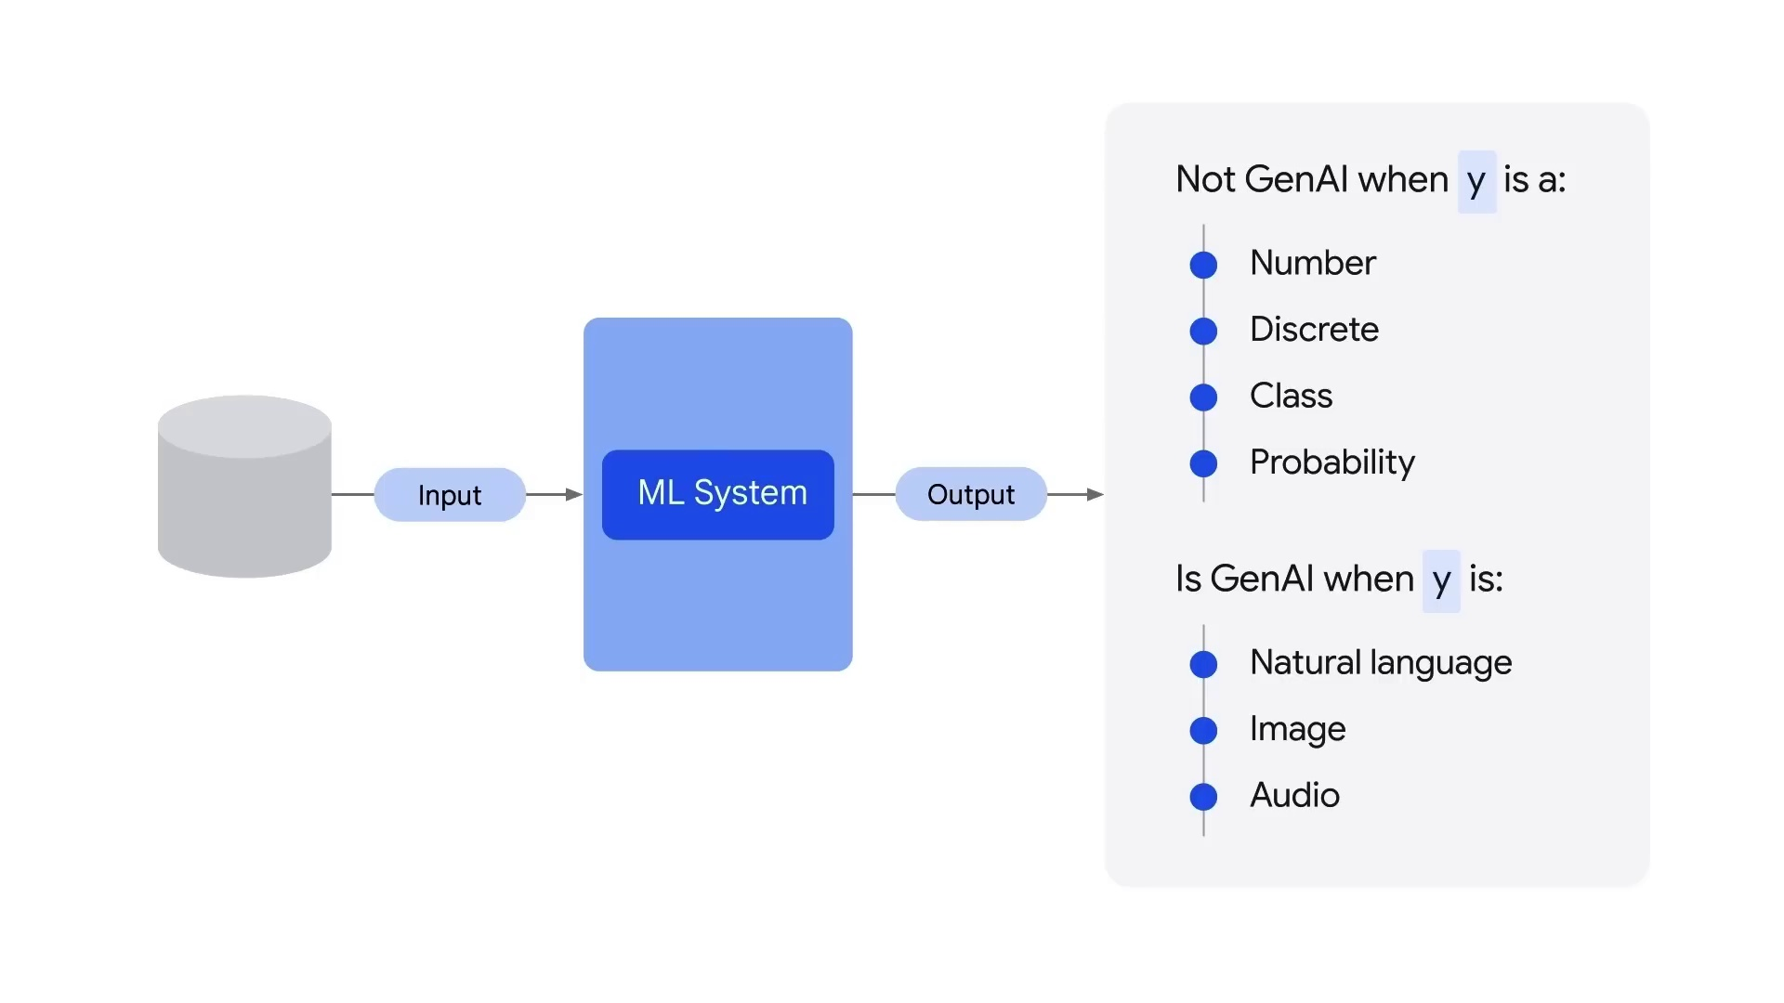
Introduction to GenAI & LLM

Slide 24
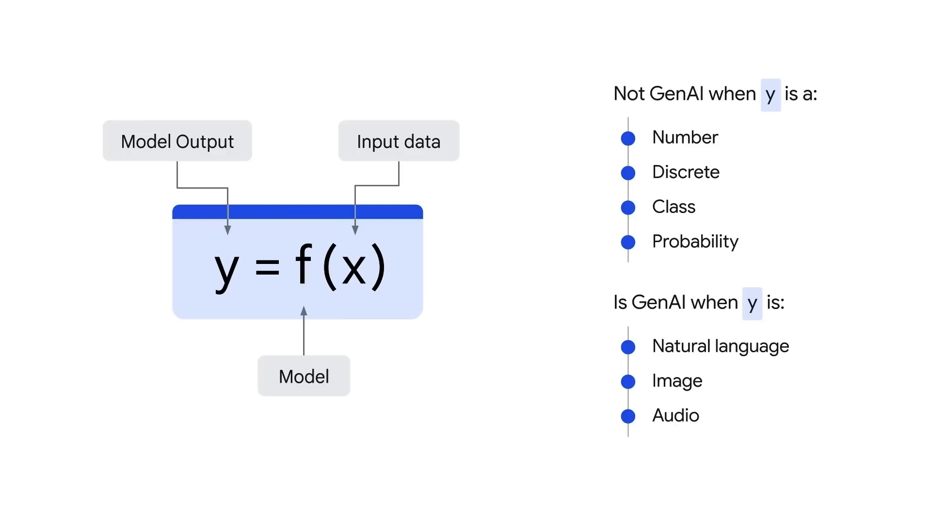
Introduction to GenAI & LLM

Slide 25
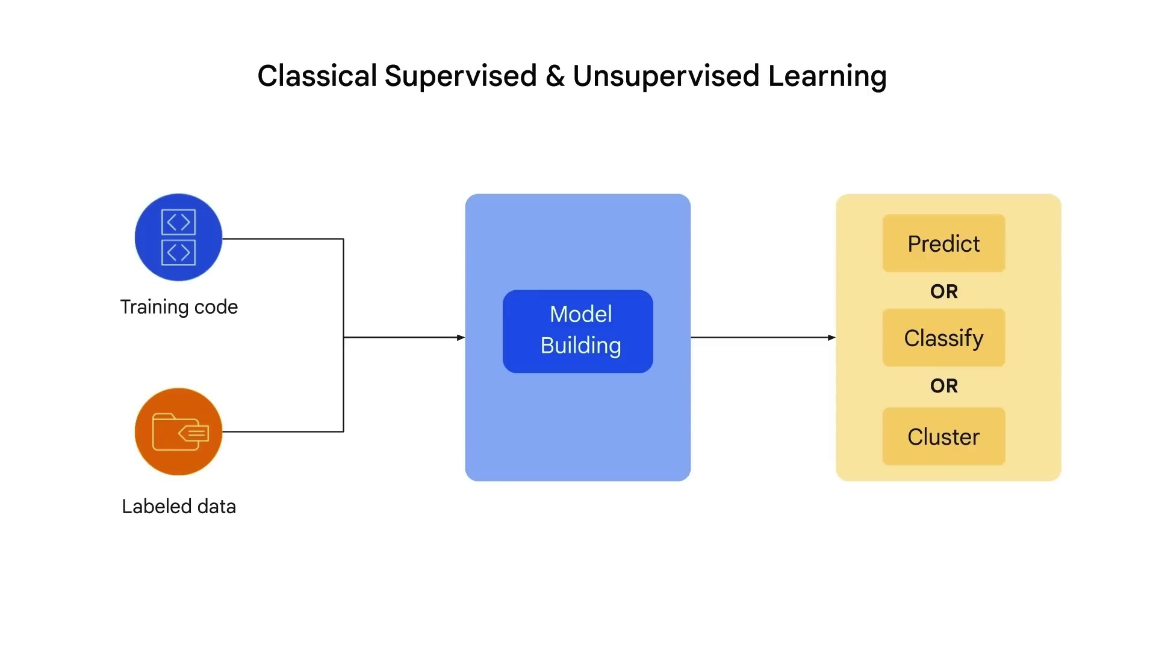
Introduction to GenAI & LLM

Slide 26
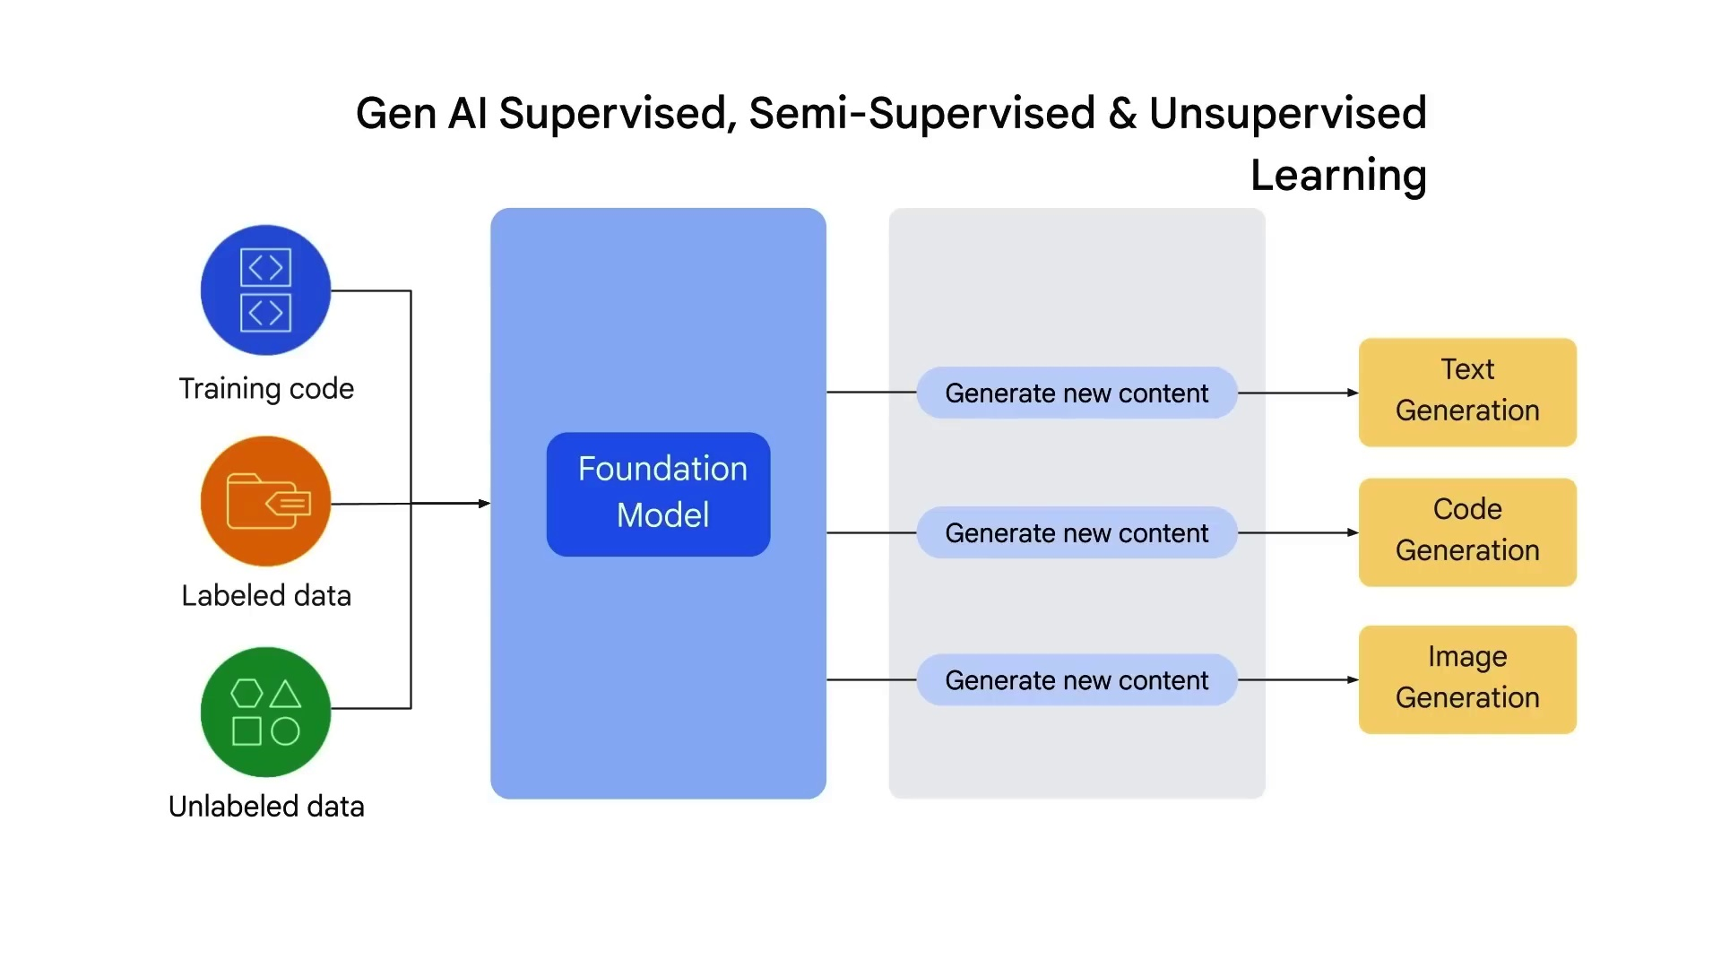
Introduction to GenAI & LLM

Slide 27
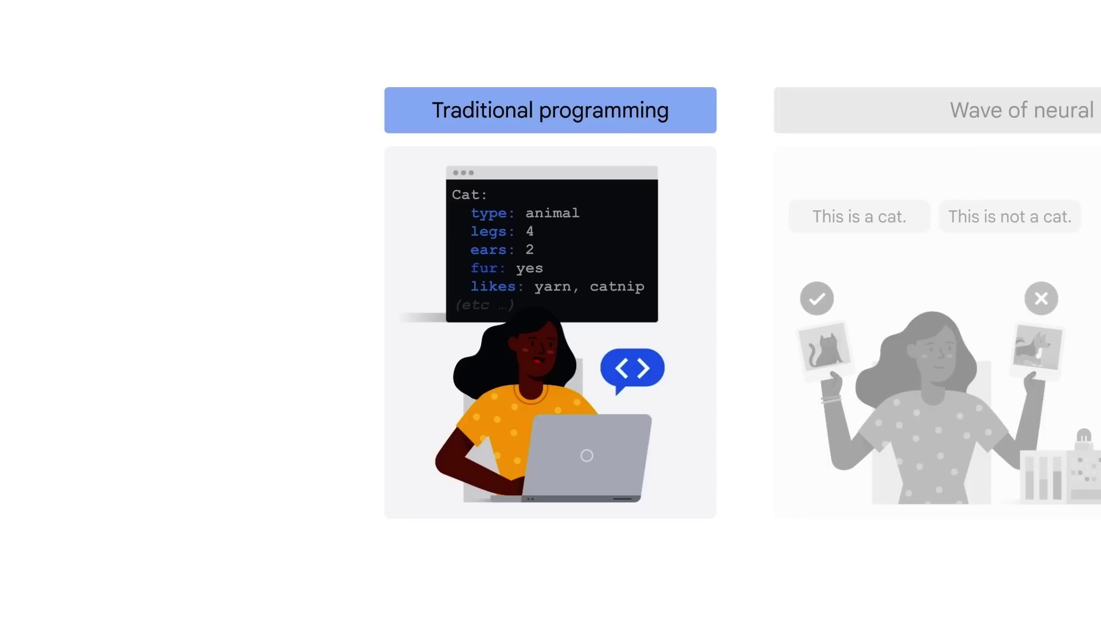
Introduction to GenAI & LLM

Slide 28
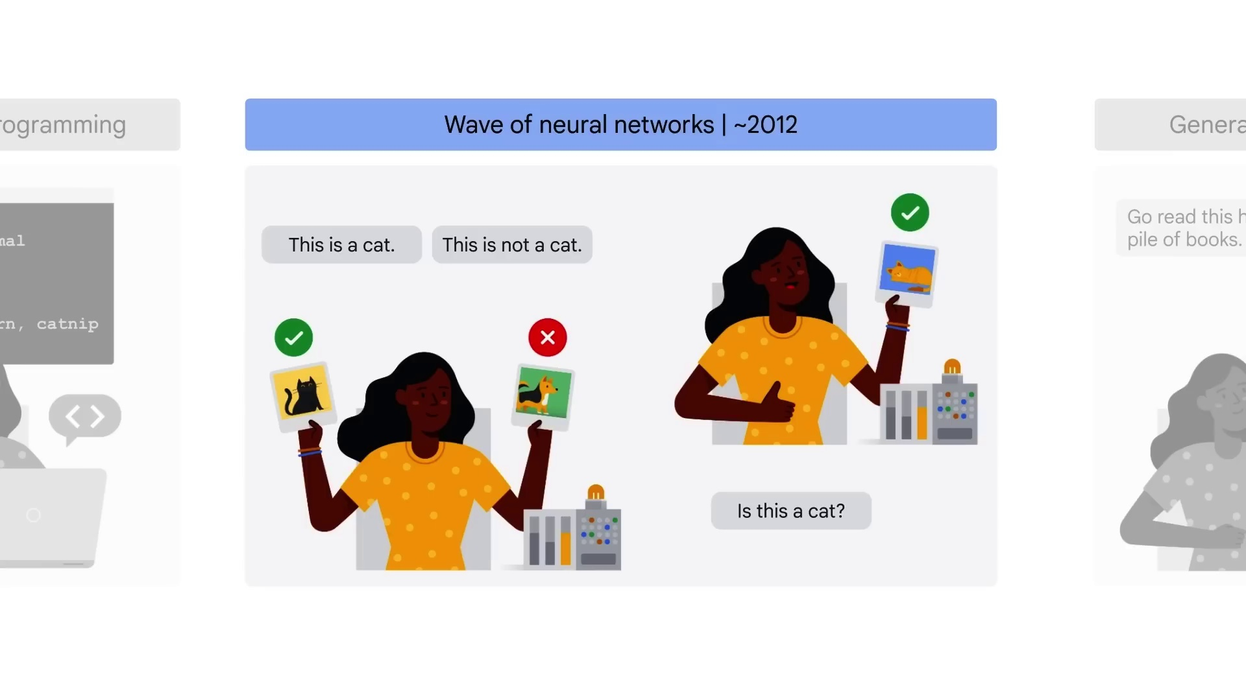
Introduction to GenAI & LLM

Slide 29
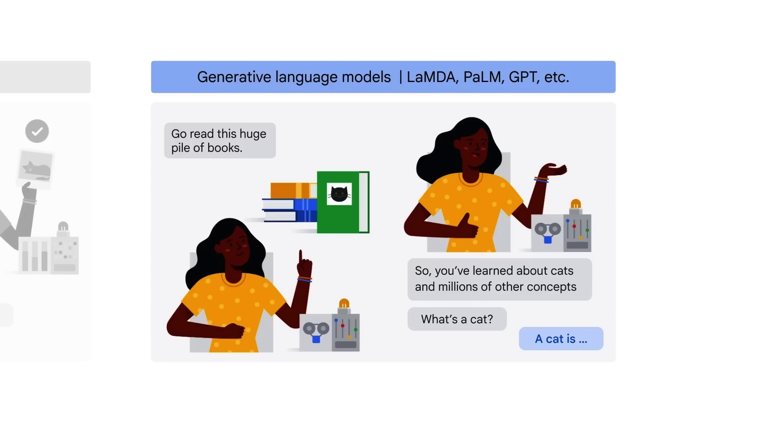
Introduction to GenAI & LLM

Slide 30
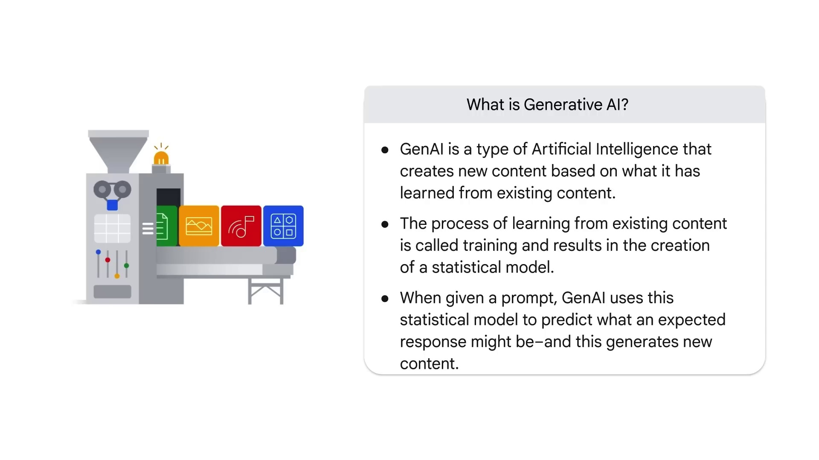
Introduction to GenAI & LLM

Slide 31
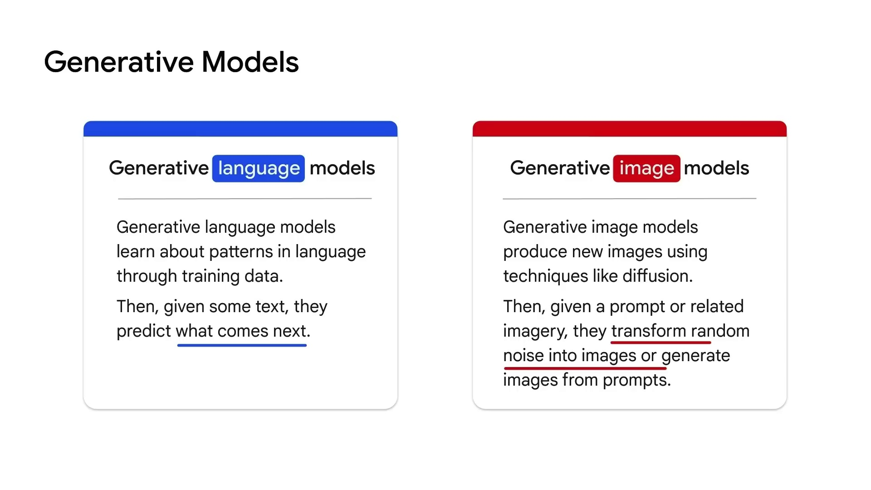
Introduction to GenAI & LLM

Slide 32
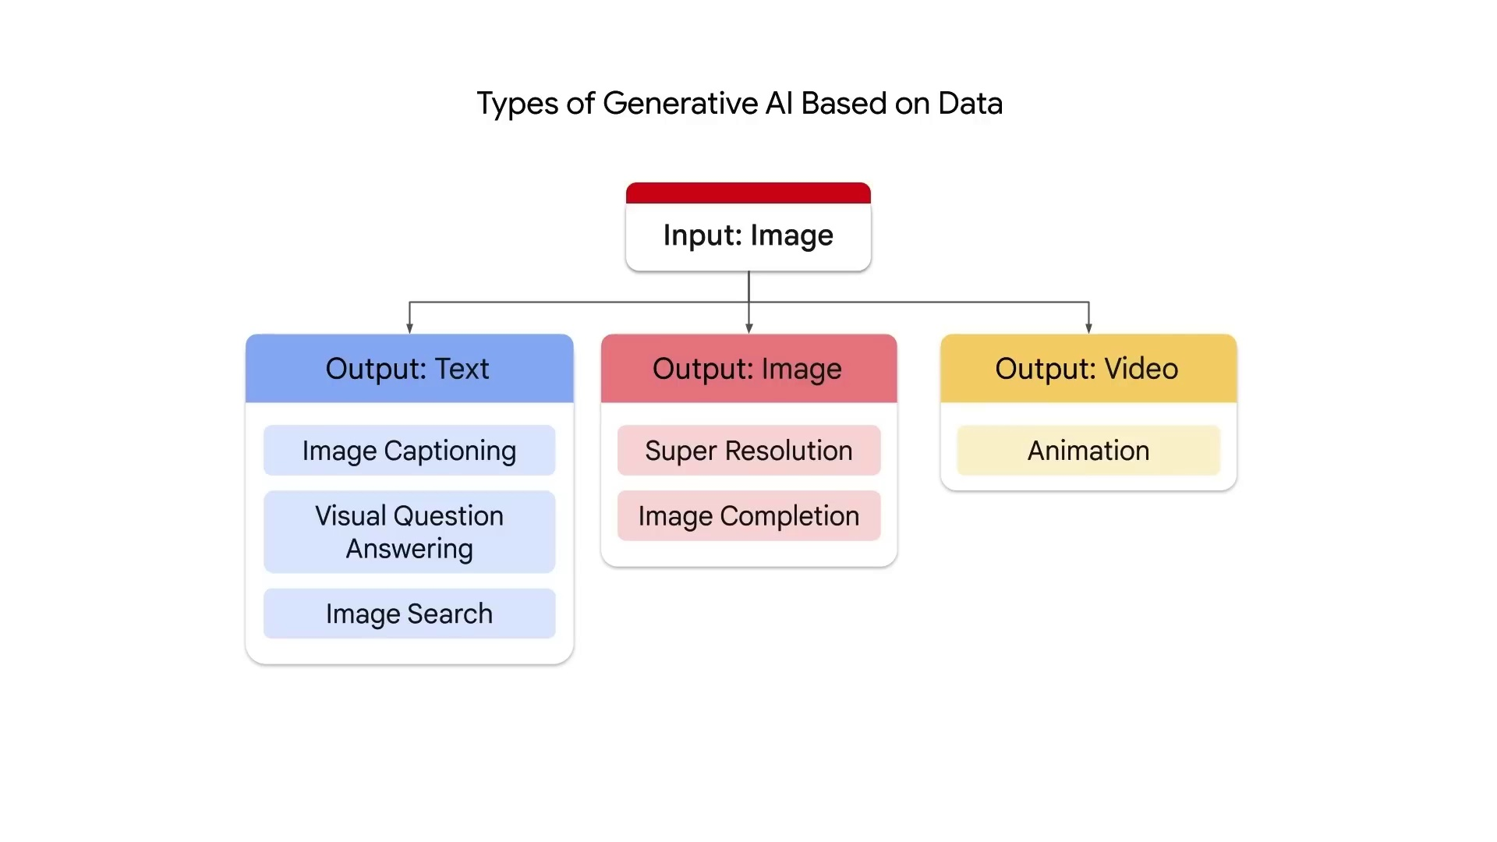
Introduction to GenAI & LLM

Slide 33
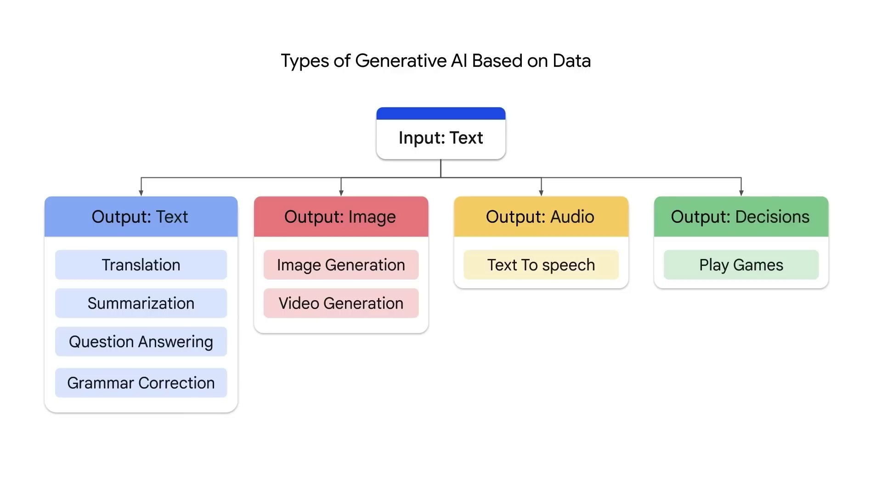
Introduction to GenAI & LLM

Slide 34
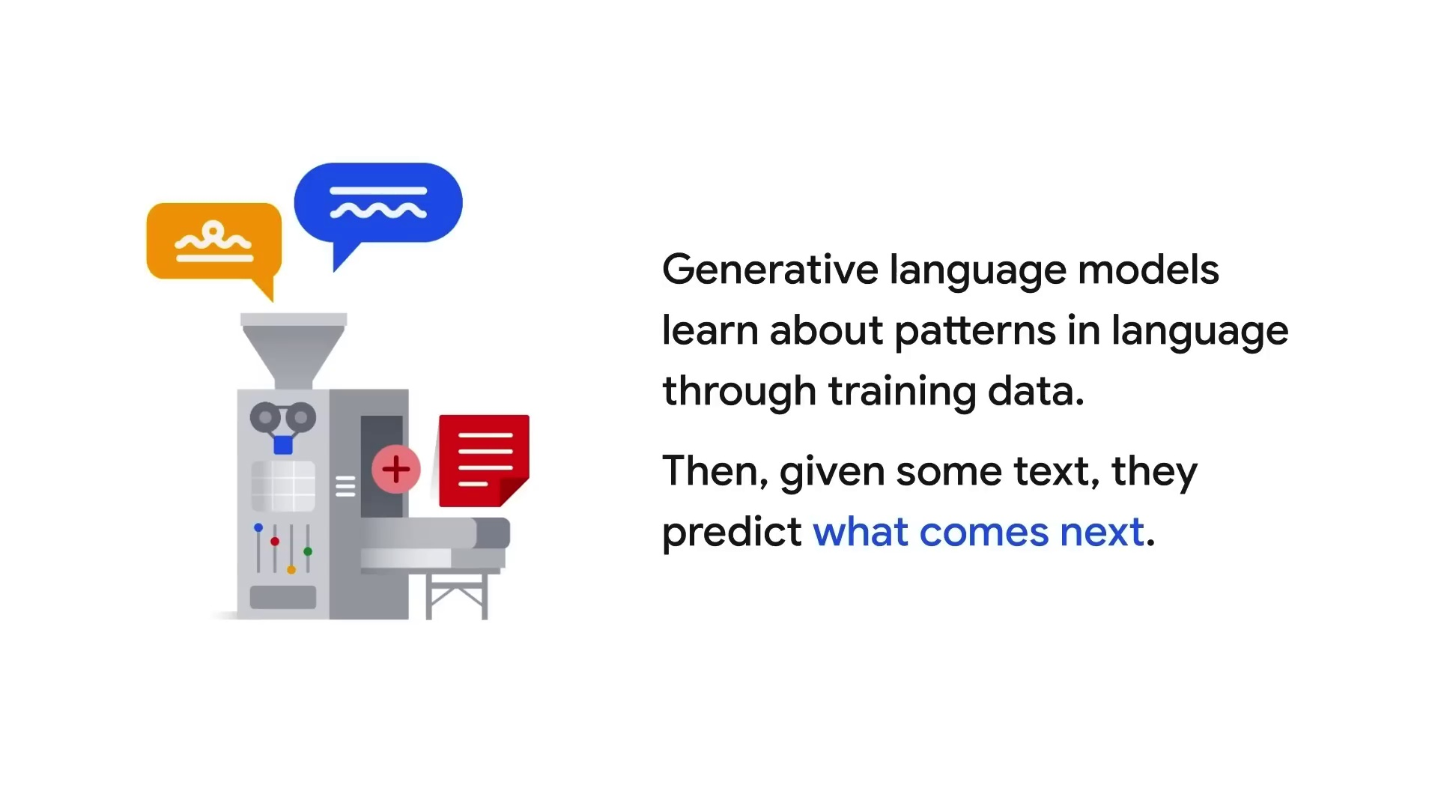
Introduction to GenAI & LLM

Slide 35
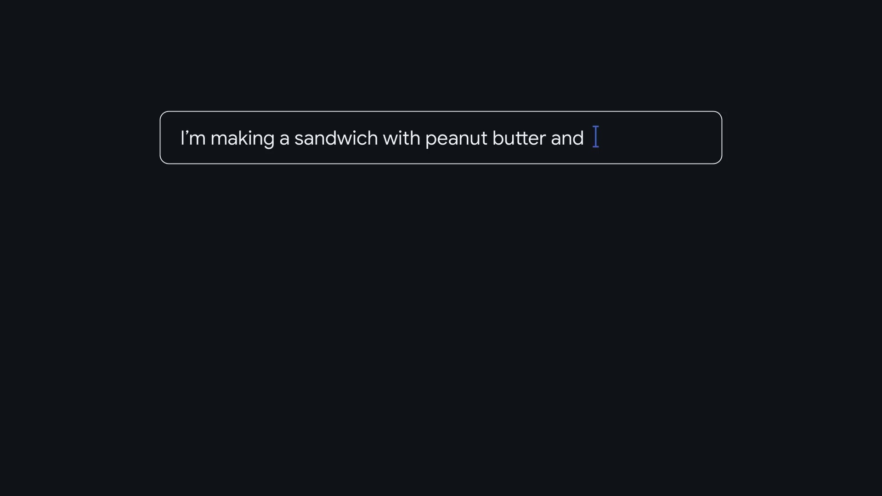
Introduction to GenAI & LLM

Slide 36
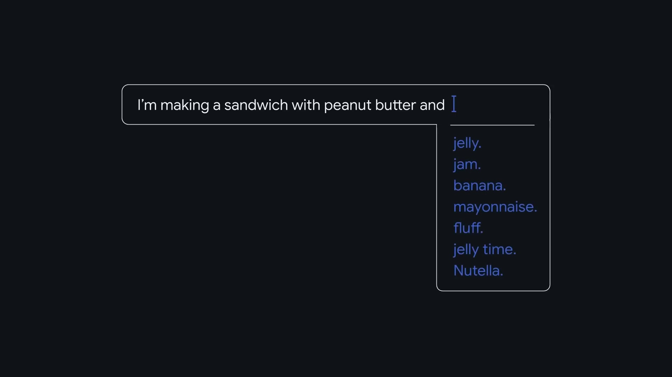
Introduction to GenAI & LLM

Slide 37
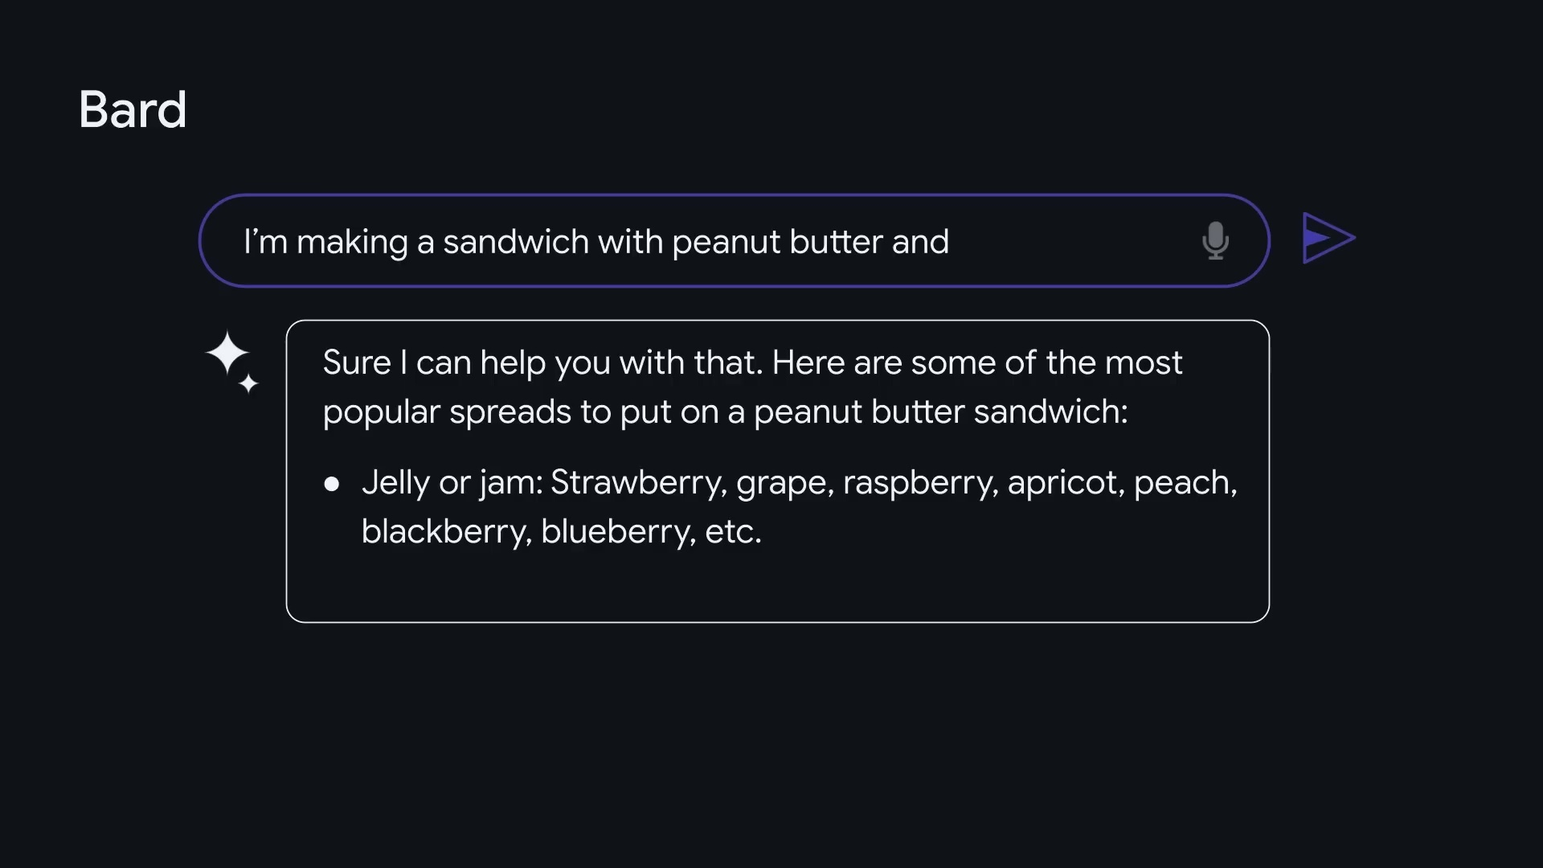
Introduction to GenAI & LLM

Slide 38
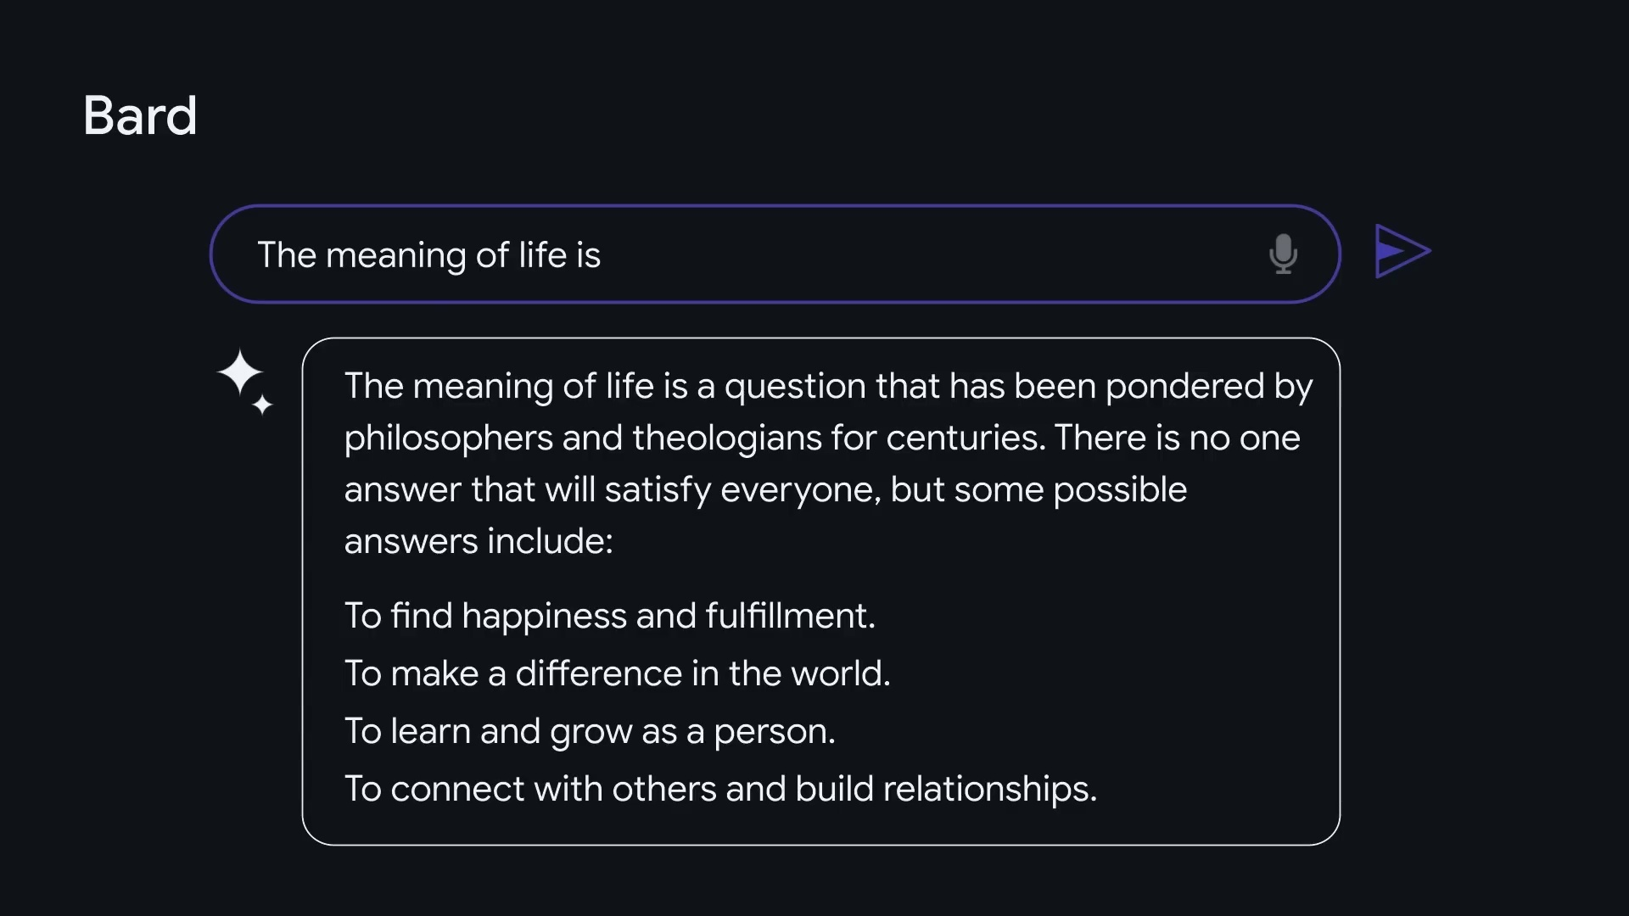
Introduction to GenAI & LLM

Slide 39
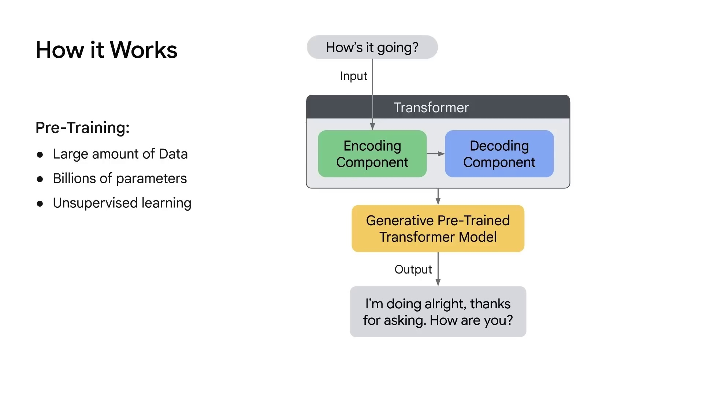
Introduction to GenAI & LLM

Slide 40

Introduction to GenAI & LLM

Slide 41
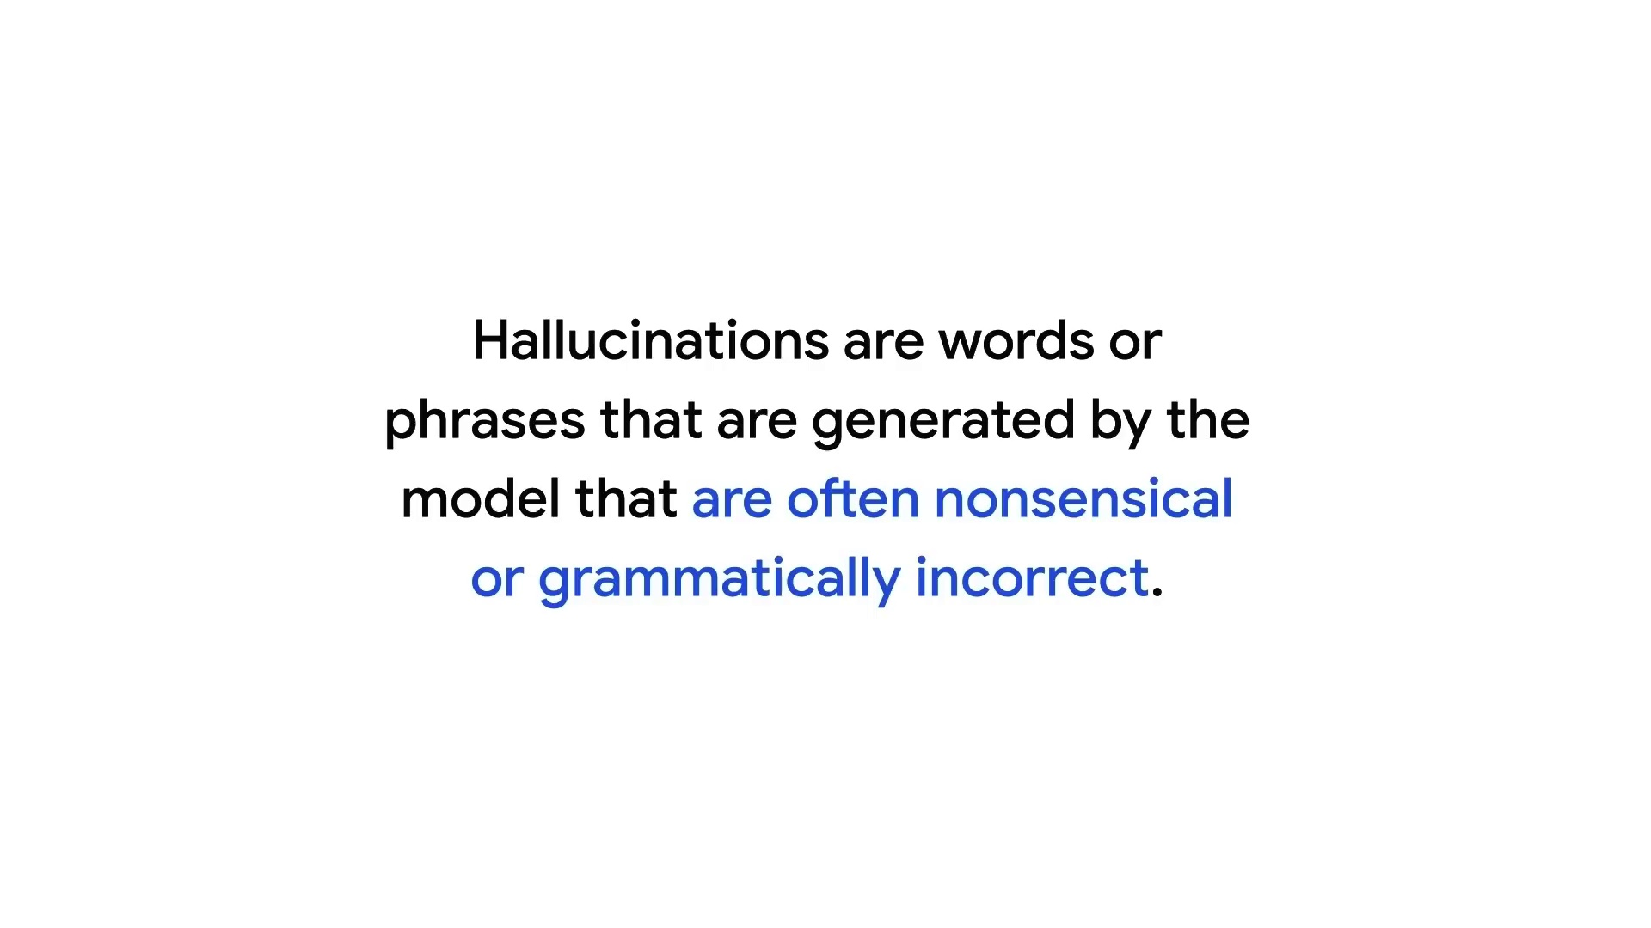
Introduction to GenAI & LLM

Slide 42
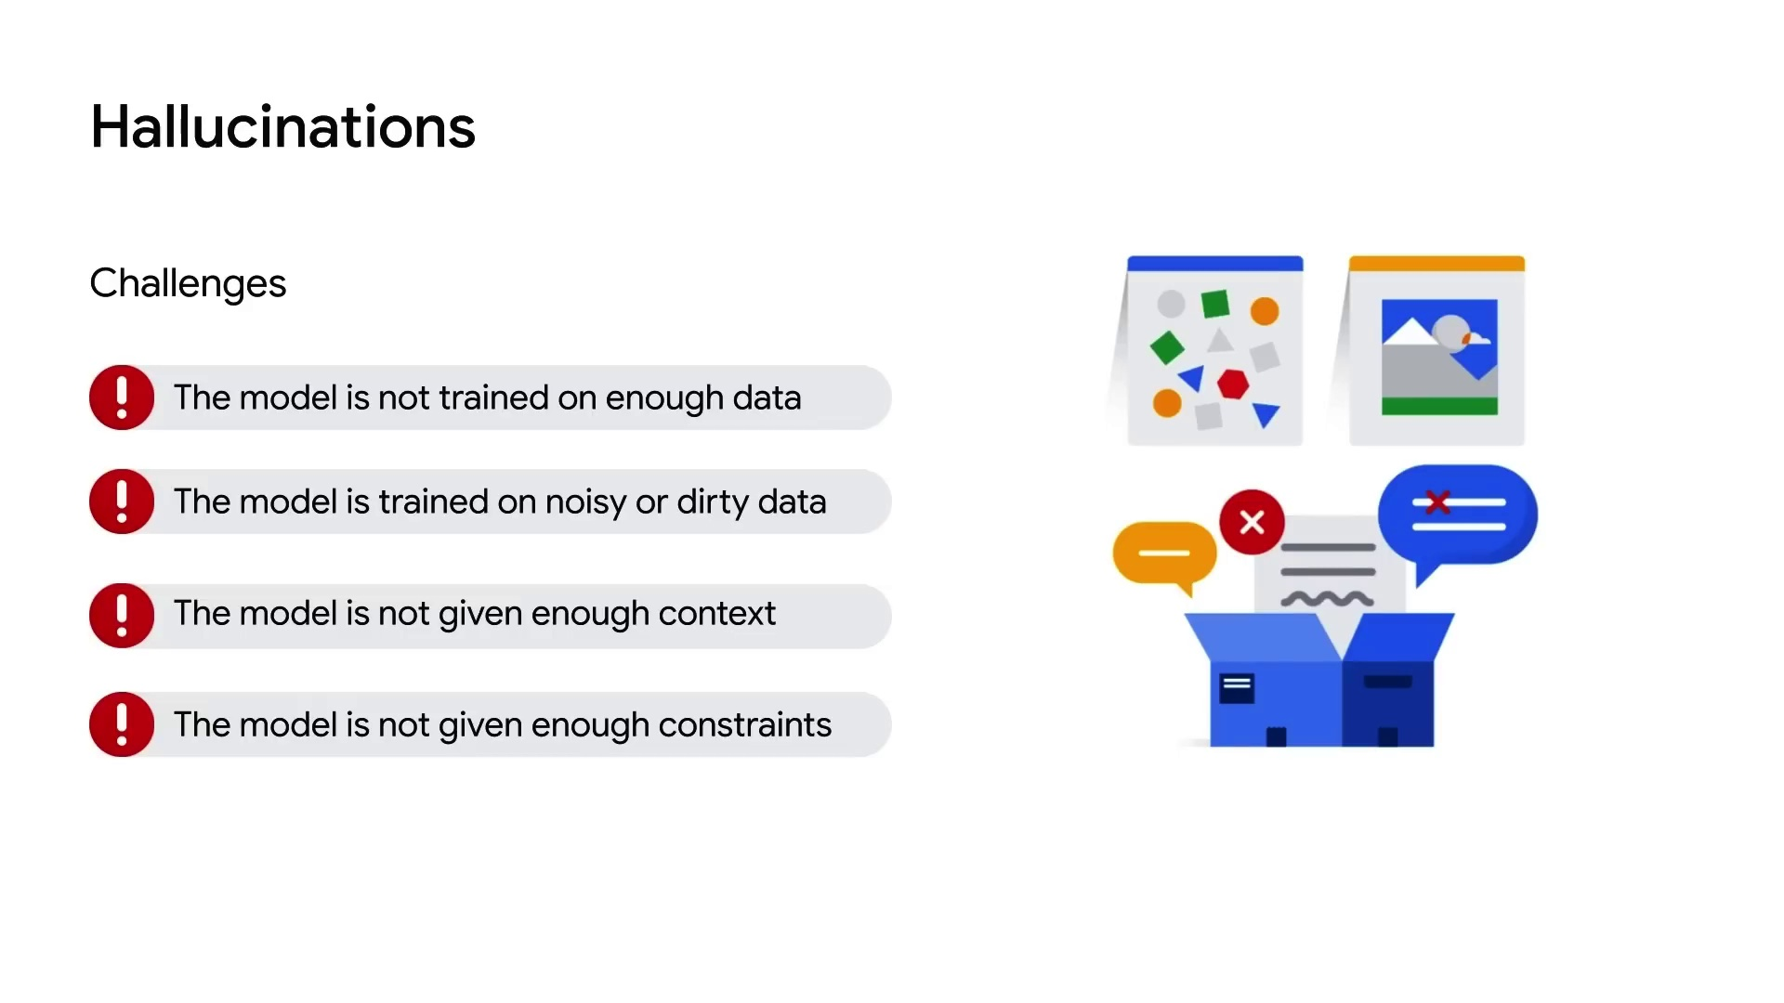
Introduction to GenAI & LLM

Slide 43
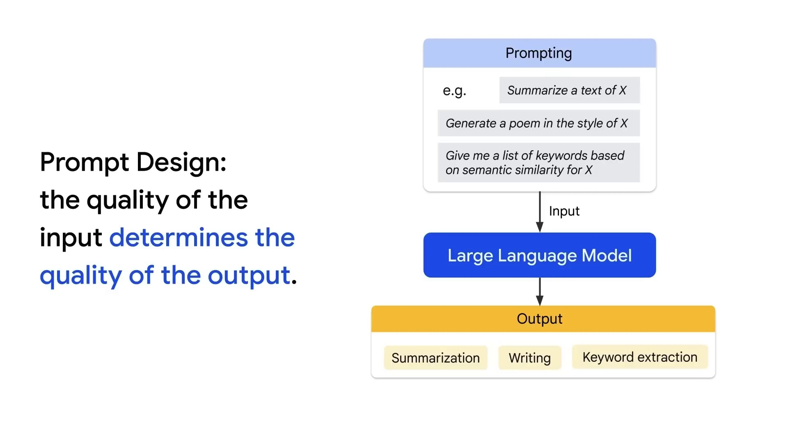
Introduction to GenAI & LLM

Slide 44
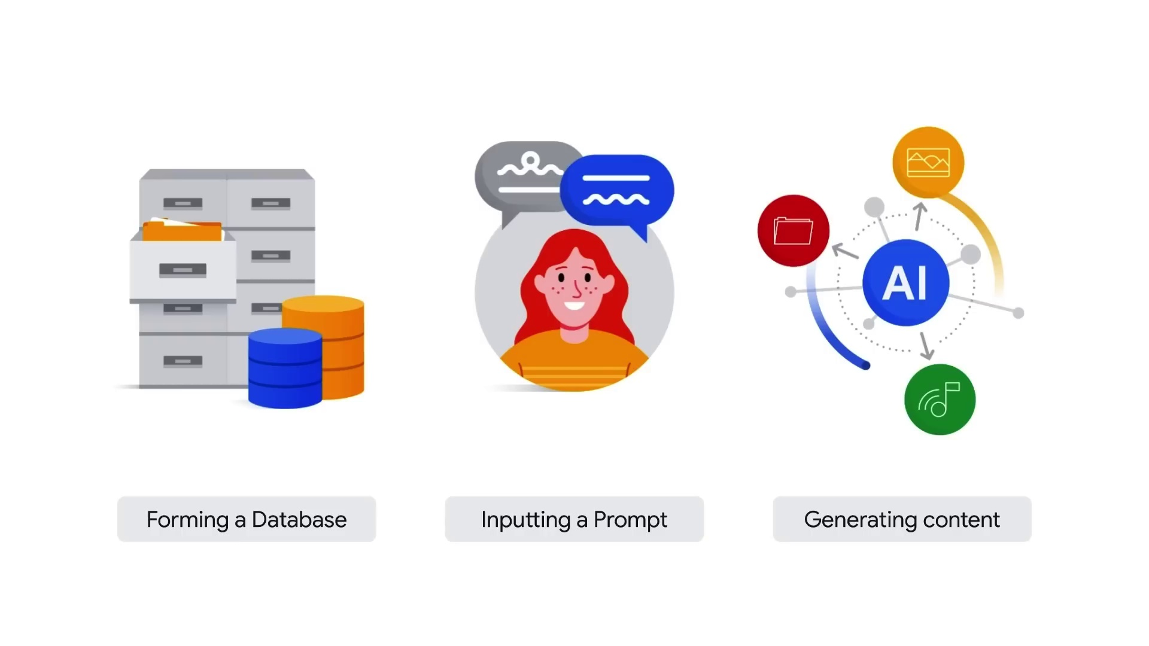
Introduction to GenAI & LLM

Slide 45
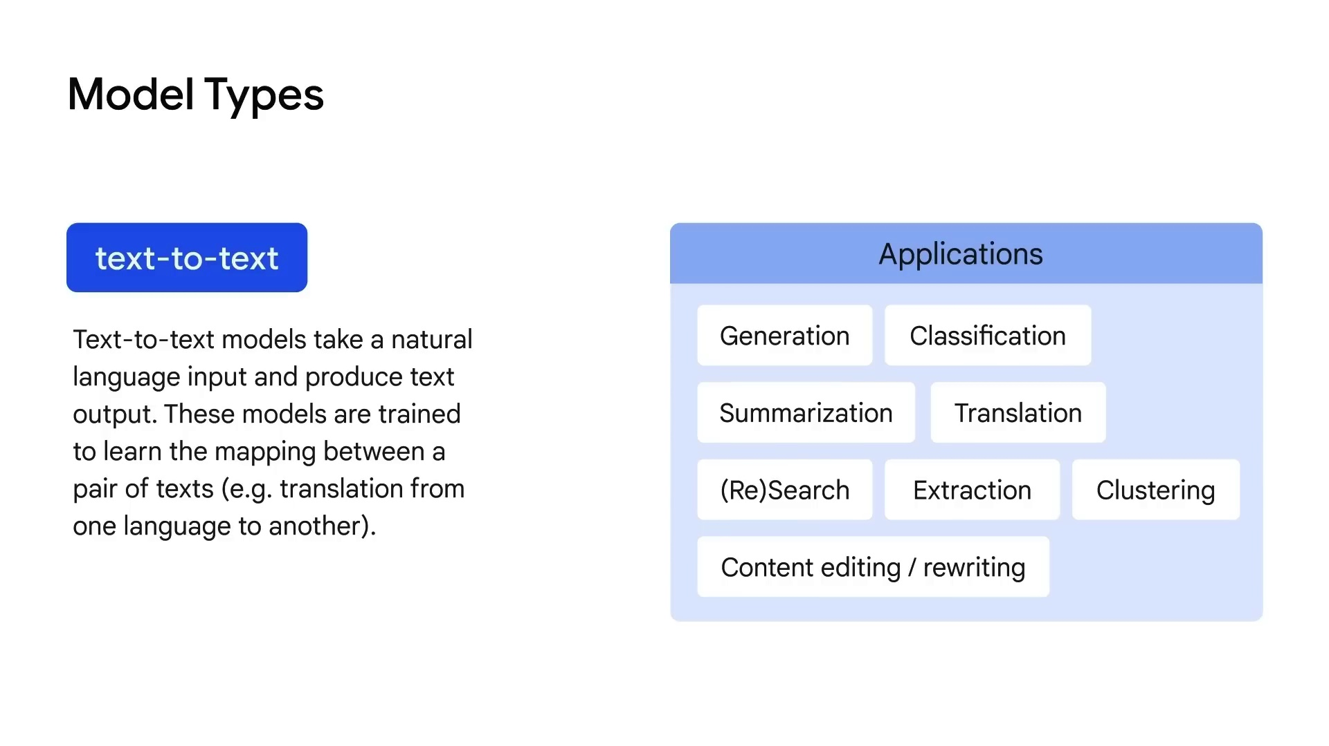
Introduction to GenAI & LLM

Slide 46
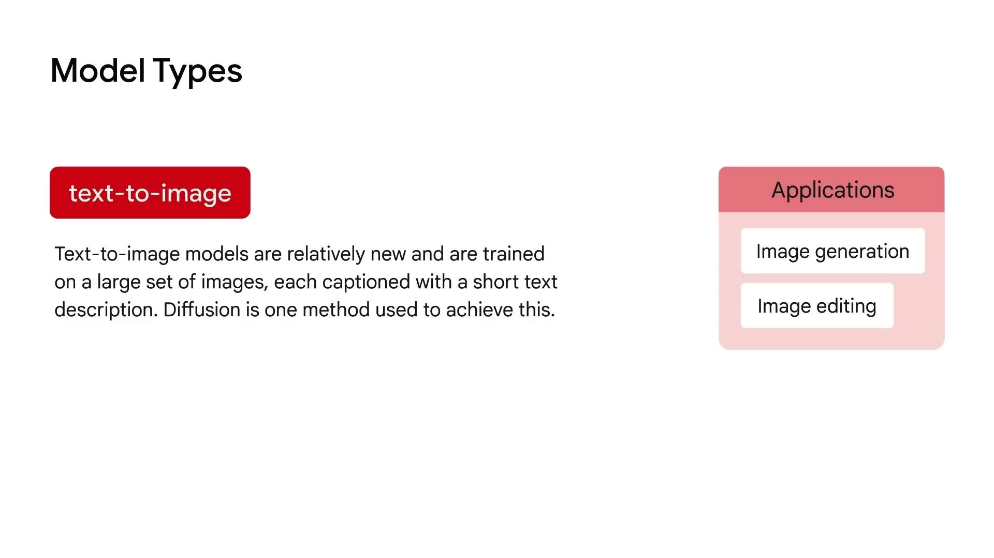
Introduction to GenAI & LLM

Slide 47
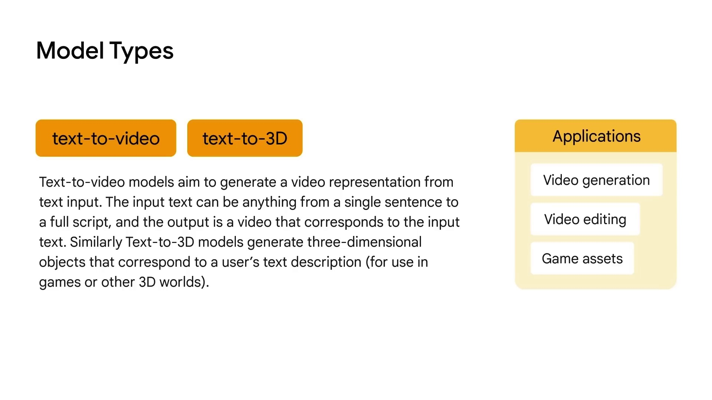
Introduction to GenAI & LLM

Slide 48
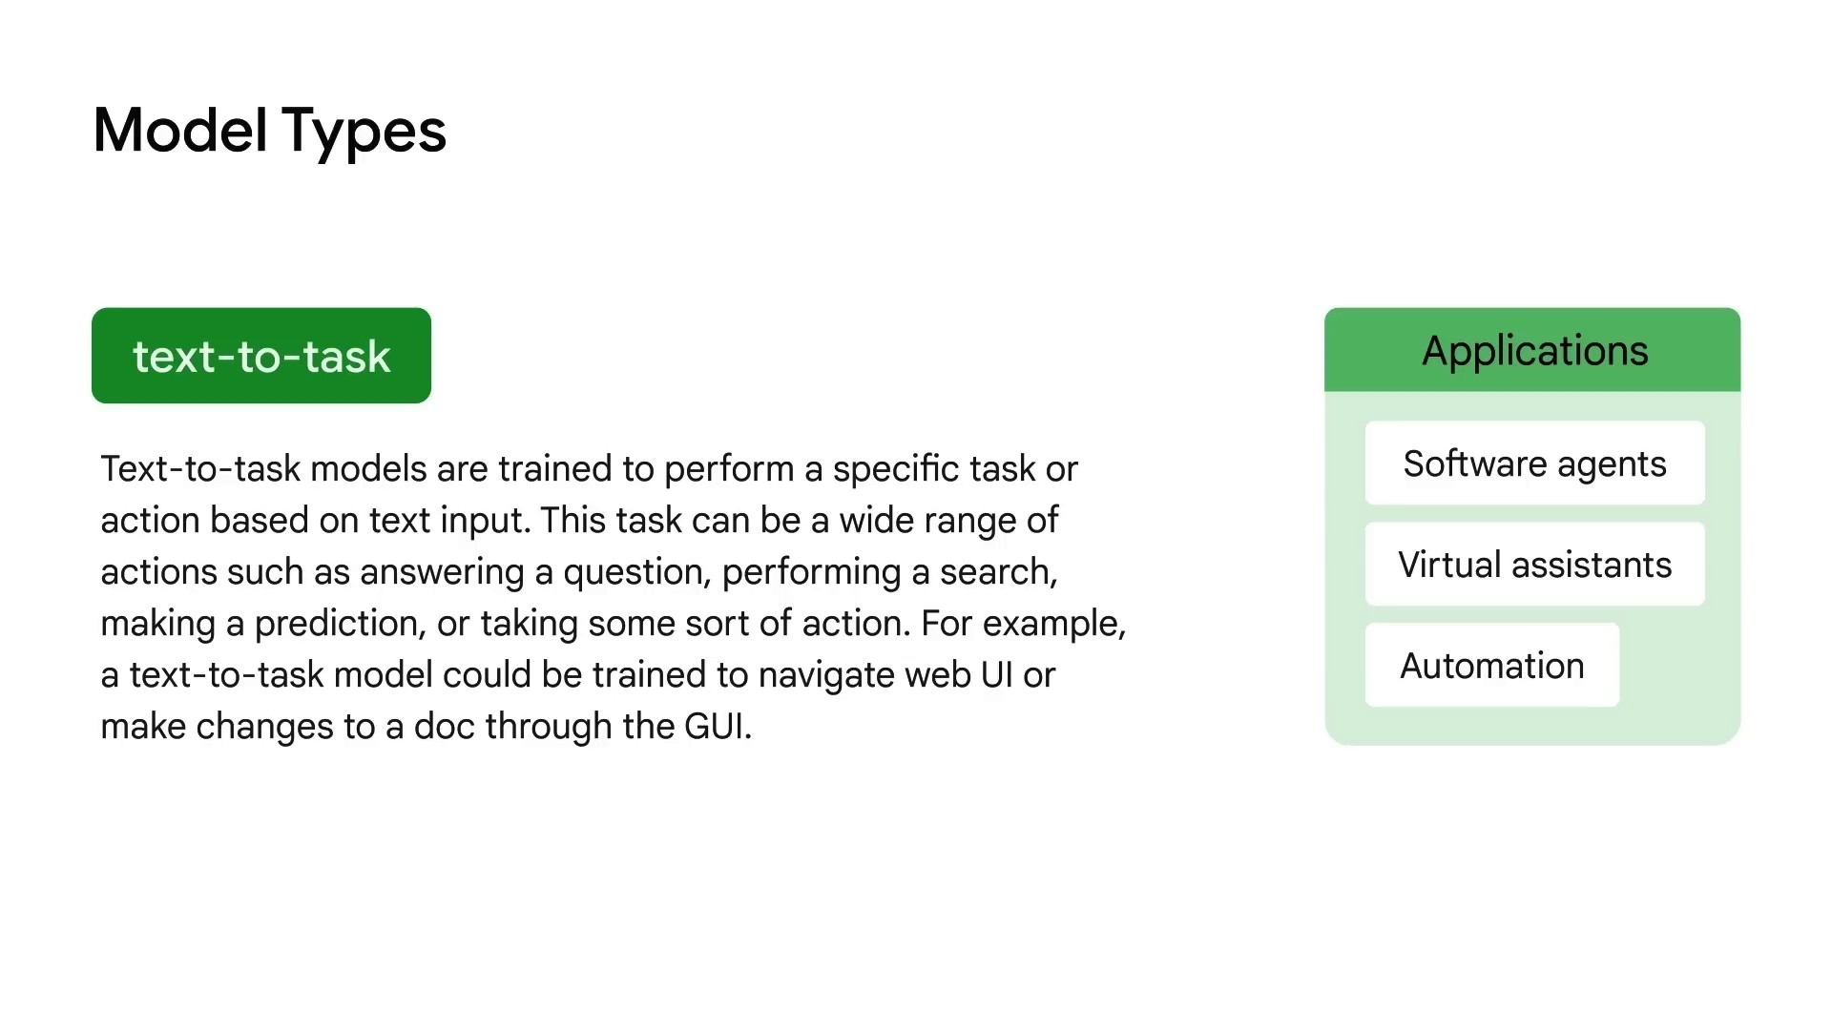
Introduction to GenAI & LLM

Slide 49
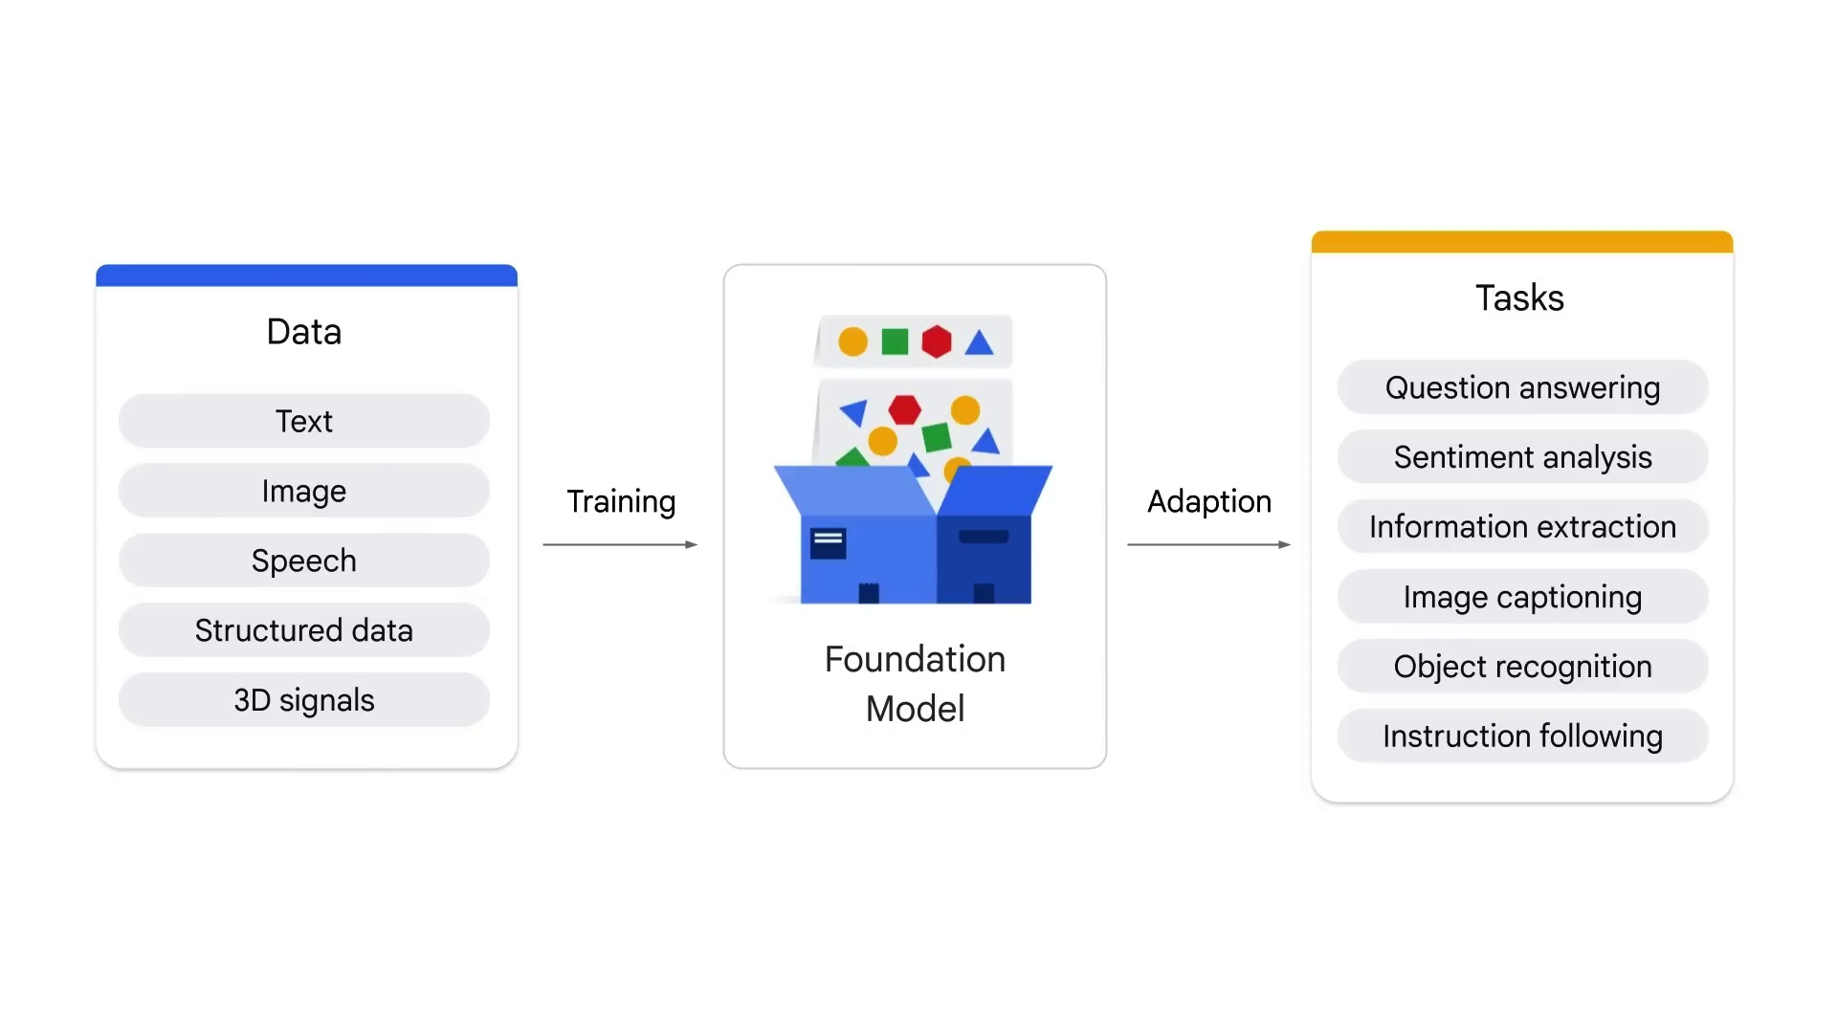
Introduction to GenAI & LLM

Slide 50
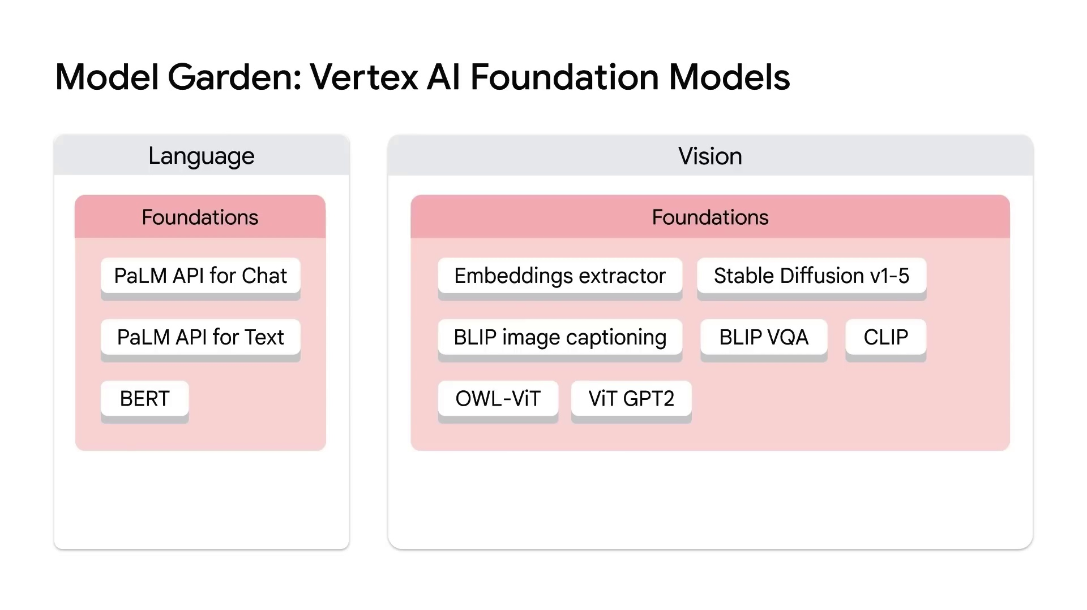
Introduction to GenAI & LLM

Slide 51
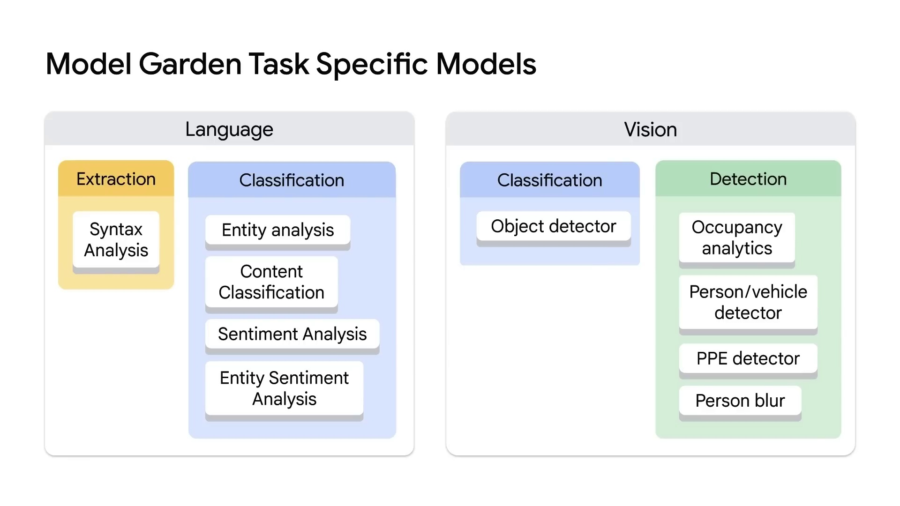
Introduction to GenAI & LLM

Slide 52
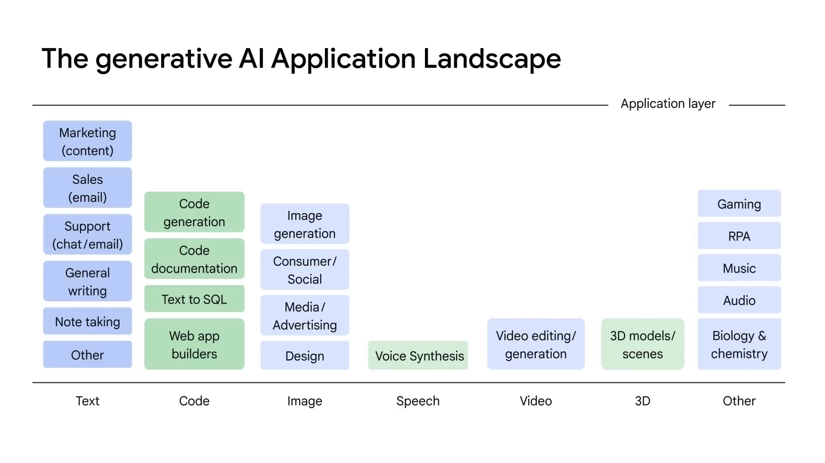
Introduction to GenAI & LLM

Slide 53

Introduction to GenAI & LLM

Slide 54

Introduction to GenAI & LLM

Slide 55

Introduction to GenAI & LLM

Slide 56

Introduction to GenAI & LLM

Slide 57

Introduction to GenAI & LLM

Slide 58

Introduction to GenAI & LLM

Slide 59

Introduction to GenAI & LLM

Slide 60

Introduction to GenAI & LLM

Slide 61

Introduction to GenAI & LLM

Slide 62

Introduction to GenAI & LLM

Slide 63

Introduction to GenAI & LLM

